Slide 1



Maintenance Management
Sai Ram B
Lecturer

Slide 2
Maintenance Management
Maintenance - It is defined as "that function of production management that is concerned with day-to-day problem of keeping the physical plant in good operating condition. It is an essential activity in every manufacturing firm, because it is necessary to ensure the availability of the machines, buildings and services needed by other parts of the organization for the performance of their function at an optimum return on investment in machines, materials and men”.

Slide 3
Maintenance Management
Maintenance management is concerned with the direction and organization of resources in order to control the availability and performance of the industrial plants to some specified level. It is a function supporting production function and is entrusted with the task of keeping the machinery, equipment and plant services in proper working condition. It also involves maintenance planning, maintenance scheduling, execution of maintenance activities (repair, breakdown and preventive maintenance) and controlling costs of maintenance.

Slide 4
Maintenance Management - Functions
Maintenance of existing plant and equipment.
Maintenance of existing plant buildings and grounds.
Equipment inspection and lubrication.
Utilities generation and distribution.
Alterations to existing equipment and buildings.
New installations of equipment and buildings.

Slide 5
Types of Maintenance
Organizations may use several type of maintenance in different type of situations. The following are the types of maintenance which typically followed by the organizations.
Break-down or Corrective Maintenance
Preventive Maintenance
Predictive Maintenance
Routine Maintenance
Planned Maintenance

Slide 6
Importance of Maintenance Management
1. Dependability of service is one of the performance measures by which a company can distinguish itself from others. To establish a competitive edge and to provide good customer service, companies must have reliable equipment that will respond to customer demand when needed. Equipment must be kept in reliable condition without costly work stoppage and down time due to repairs if the company is to remain productive and competitive.

Slide 7
Importance of Maintenance Management
2. Maintenance is an important factor in quality assurance which is another basis for successful competitive edge. Inconsistencies in equipment leads to variability in product characteristics and result in defective parts that fail to meet the established specifications. Beyond just preventing break downs, it is necessary to keep equipment operating within specifications (i.e., process capability) that will produce high level of quality.

Slide 8
Importance of Maintenance Management
3. Many manufacturing organizations, particularly those with JIT Just-In-Time) programs are operating with inventories so low that they offer no protection in the event of a lengthy equipment failure. Beyond the cost of idle equipment, idle labour and lost sales that can result from a breakdown, there is a danger of permanently losing market shares to companies that are more reliable. Maintenance function can help prevent such an occurrence.

Slide 9
Importance of Maintenance Management
4. Good maintenance management is important for the company's cost control. As companies go in for automation to become more competitive, they increasingly rely on equipment to produce a greater percentage of their output. It becomes more important that equipment operate reliably within specifications. The cost of idle time is higher as equipment becomes more high-tech and expensive, e.g., NC/CNC machines and robots.

Slide 10
Importance of Maintenance Management
5. Organisations like airlines and oil refineries have huge investment in equipment. Equipment failure will be disastrous for such companies. They need proper maintenance to maintain equipment in good condition.

Slide 11

Operations Management

Slide 12
Operations Management
Operations management is a field of business management that focuses on planning, designing, overseeing and controlling an organization's production processes and the efficient use of resources to achieve specific objectives.
It plays a crucial role in ensuring that an organization's day-to-day operations are carried out effectively and efficiently, contributing to its overall success.

Slide 13
Production System
The production system is ‘that part of an organization, which produces products of an organization. It is that activity whereby resources, flowing within a defined system, are combined and transformed in a controlled manner to add value in accordance with the policies communicated by management’.

Slide 14
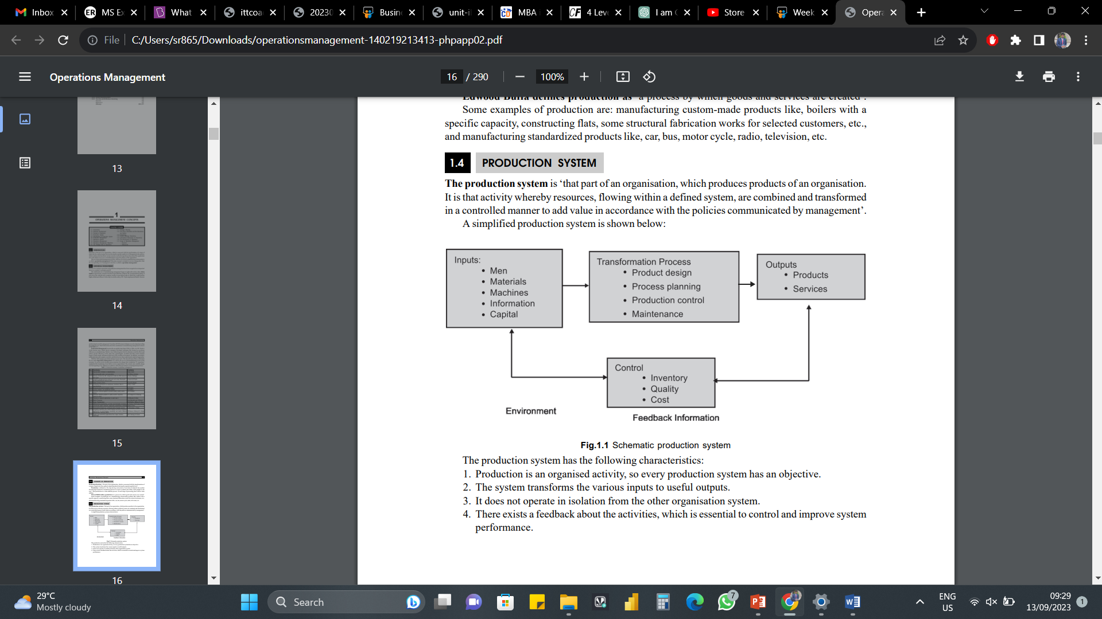
Production System

Slide 15
Characteristics of Production System
Production is an organized activity, so every production system has an objective.
2. The system transforms the various inputs to useful outputs
3. It does not operate in isolation from the other organization system.
4. There exists a feedback about the activities, which is essential to control and improve system performance.

Slide 16
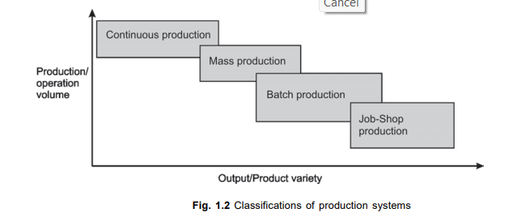
Types of Production Systems
Job-Shop Production
Batch Production
3. Mass Production
4. Continuous Production

Slide 17
Characteristics of Job-Shop Production
1. High variety of products and low volume.
2. Use of general purpose machines and facilities.
3. Highly skilled operators who can take up each job as a challenge because of uniqueness.
4. Large inventory of materials, tools, parts.
5. Detailed planning is essential for sequencing the requirements of each product, capacities for each work centre and order priorities.

Slide 18
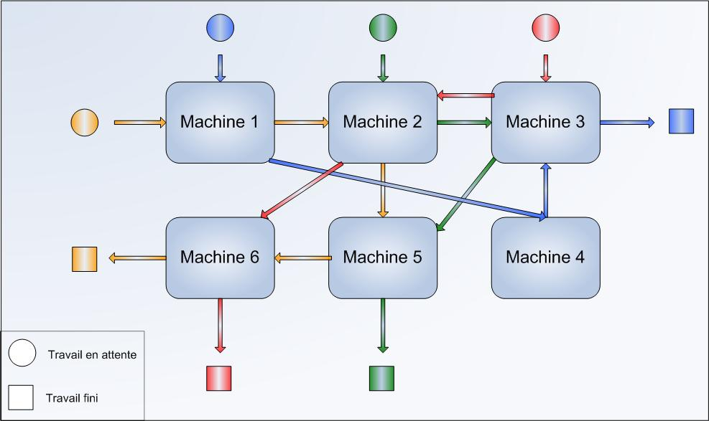
Job-Shop Production

Slide 19
Advantages of Job-Shop Production
1. Because of general purpose machines and facilities variety of products can be produced.
2. Operators will become more skilled and competent, as each job gives them learning opportunities.
3. Full potential of operators can be utilised.
4. Opportunity exists for Creative methods and innovative ideas.

Slide 20
Limitations of Job-Shop Production
1. Higher cost due to frequent set up changes.
2. Higher level of inventory at all levels and hence higher inventory cost.
3. Production planning is complicated.
4. Larger space requirements.

Slide 21
Characteristics of Batch Production
1. Shorter production runs.
2. Plant and machinery are flexible.
3. Plant and machinery set up is used for the production of item in a batch and change of set up is required for processing the next batch.
4. Manufacturing lead-time and cost are lower as compared to job order production.

Slide 22
Advantages of Batch Production
1. Better utilisation of plant and machinery.
2. Promotes functional specialisation.
3. Cost per unit is lower as compared to job order production.
4. Lower investment in plant and machinery.
5. Flexibility to accommodate and process number of products.
6. Job satisfaction exists for operators.

Slide 23
Limitations of Batch Production
1. Material handling is complex because of irregular and longer flows.
2. Production planning and control is complex.
3. Work in process inventory is higher compared to continuous production.
4. Higher set up costs due to frequent changes in set up.

Slide 24
Characteristics of Mass Production
1. Standardisation of product and process sequence.
2. Dedicated special purpose machines having higher production capacities and output rates.
3. Large volume of products.
4. Shorter cycle time of production.
5. Material handling can be completely automatic.
6. Perfectly balanced production lines.
7. Flow of materials, components and parts is continuous and without any back tracking.
8. Production planning and control is easy.

Slide 25
Advantages of Mass Production
1. Higher rate of production with reduced cycle time.
2. Higher capacity utilisation due to line balancing.
3. Less skilled operators are required.
4. Low process inventory.
5. Manufacturing cost per unit is low.

Slide 26
Limitations of Mass Production
1. Breakdown of one machine will stop an entire production line.
2. Line layout needs major change with the changes in the product design.
3. High investment in production facilities.
4. The cycle time is determined by the slowest operation.

Slide 27
Characteristics of Continuous Production
1. Dedicated plant and equipment with zero flexibility.
2. Material handling is fully automated.
3. Process follows a predetermined sequence of operations.
4. Component materials cannot be readily identified with final product.
5. Planning and scheduling is a routine action.

Slide 28
Advantages of Continuous Production
1. Standardisation of product and process sequence.
2. Higher rate of production with reduced cycle time.
3. Higher capacity utilisation due to line balancing.
4. Manpower is not required for material handling as it is completely automatic.
5. Person with limited skills can be used on the production line.
6. Unit cost is lower due to high volume of production.

Slide 29
Limitations of Continuous Production
1. Flexibility to accommodate and process number of products does not exist.
2. Very high investment for setting flow lines.
3. Product differentiation is limited.

Slide 30
Manufacturing Operations Vs. Service Operations
Manufacturing operations and Service operations are two broad categories within the field of Operations Management and they represent different types of processes for delivering products and value to customers.
Here are the key differences between manufacturing and service operations:

Slide 31
Nature of Output in Manufacturing
These operations involve the production of tangible, physical goods. These goods can be raw materials, components or finished products. Manufacturing operations typically focus on transforming inputs (raw materials, labor and equipment) into tangible products.

Slide 32
Nature of Output in Service
Service operations, on the other hand, involve the delivery of intangible services to customers. Services can include healthcare, education, hospitality, consulting, banking and more. The "output" of service operations is often a customer experience or a result, rather than a physical product.

Slide 33
Tangibility in Manufacturing & Service
These operations deal with tangible and measurable products. Quality control often involves physical inspections and measurements.
Services are intangible and often involve interactions, experiences and perceptions. Quality in service operations may be more subjective and related to customer satisfaction.

Slide 34
Production Process in Manufacturing & Service
The production process in manufacturing is often linear and involves a series of physical transformations, including assembly lines, machining, and material processing.
The production process in services can be more dynamic and people-centric. It often involves interactions between employees and customers. For example, in healthcare, a patient's treatment is a service that requires continuous interaction between doctors and the patient.

Slide 35
Inventory in Manufacturing & Service
Manufacturing operations typically involve managing physical inventories of raw materials, work-in-progress (WIP) and finished goods.
Service operations generally do not have physical inventories in the same way manufacturing does. Instead, they may deal with scheduling, appointment management and resource allocation.

Slide 36
Quality Control in Manufacturing & Service
Quality control in manufacturing often relies on measurable metrics such as defect rates, tolerances and consistency in product specifications.
Quality in service operations is often assessed through customer feedback, employee performance evaluations and adherence to service standards. It can be more subjective and perception-based.

Slide 37
Customer Interaction in Manufacturing & Service
Customer interaction in manufacturing is usually limited to the purchase of products. After-sales service may be required for maintenance or repairs.
Customer interaction is a fundamental part of service operations. Customers directly interact with employees and their experience often plays a significant role in the success of the service.

Slide 38
Capacity Management in Manufacturing & Service
Capacity planning in manufacturing is focused on optimizing production volumes and balancing supply and demand for physical products.
Capacity management in services is about scheduling staff and resources to meet demand for services, which can be influenced by factors like peak times and customer preferences.

Slide 39
Manufacturing Vs. Service Overview
In summary, manufacturing operations involve the production of tangible goods through physical processes, while service operations provide intangible services through interactions and experiences.
These differences lead to variations in the management, quality control and customer interaction aspects of these two types of operations. Many businesses may combine elements of both manufacturing and service operations, especially in today's complex and interconnected business landscape.

Slide 40
Objectives of Operations Management
Objectives of Operations Management can be categorized into Customer Service and Resource Utilisation.
Customer Service
The first objective of operating systems is to utilize resources for the satisfaction of customer wants. Therefore, customer service is a key objective of operations management.

Slide 41
Customer Service
The operating system must provide something to a specification, which can satisfy the customer in terms of cost and timing. Thus, providing the ‘right thing at a right price at the right time’ can satisfy primary objective.
These aspects of customer service – specification, cost and timing – are described for four functions. They are the principal sources of customer satisfaction and must therefore be the principal dimension of the customer service objective for operations managers.

Slide 42
Customer Service
Generally, an organisation will aim reliably and consistently to achieve certain standards and operations manager will be influential in attempting to achieve these standards. Hence, this objective will influence the operations manager’s decisions to achieve the required customer service.

Slide 43
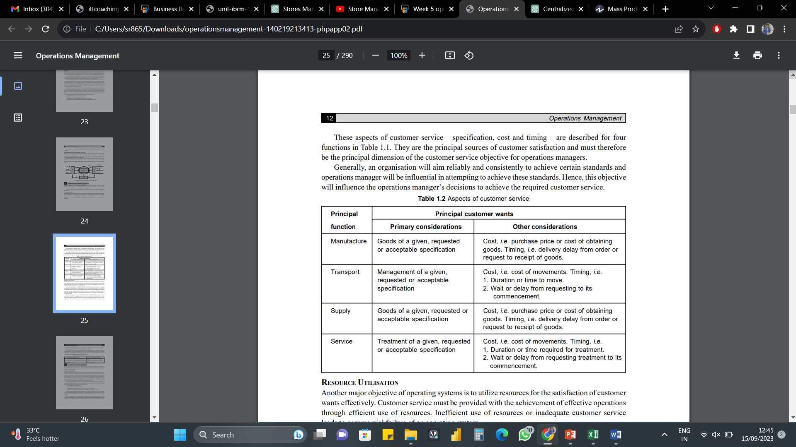
Aspects of Customer Service

Slide 44
Resource Utilization
Another major objective of operating systems is to utilize resources for the satisfaction of customer wants effectively.
Customer service must be provided with the achievement of effective operations through efficient use of resources. Inefficient use of resources or inadequate customer service leads to commercial failure of an operating system.

Slide 45
Resource Utilization
Operations management is concerned essentially with the utilisation of resources, i.e. obtaining maximum effect from resources or minimising their loss, under utilisation or waste. The extent of the utilisation of the resources’ potential might be expressed in terms of the proportion of available time used or occupied, space utilisation, levels of activity etc. Each measure indicates the extent to which the potential or capacity of such resources is utilised. This is referred as the objective of resource utilisation.

Slide 46
Resource Utilization
Operations management is concerned with the achievement of both satisfactory customer service and resource utilisation. An improvement in one will often give rise to deterioration in the other. Often both cannot be maximized and hence a satisfactory performance must be achieved on both objectives. All the activities of operations management must be tackled with these two objectives in mind and because of this conflict, operations managers’ will face many of the problems. Hence, operations managers must attempt to balance these basic objectives.

Slide 47
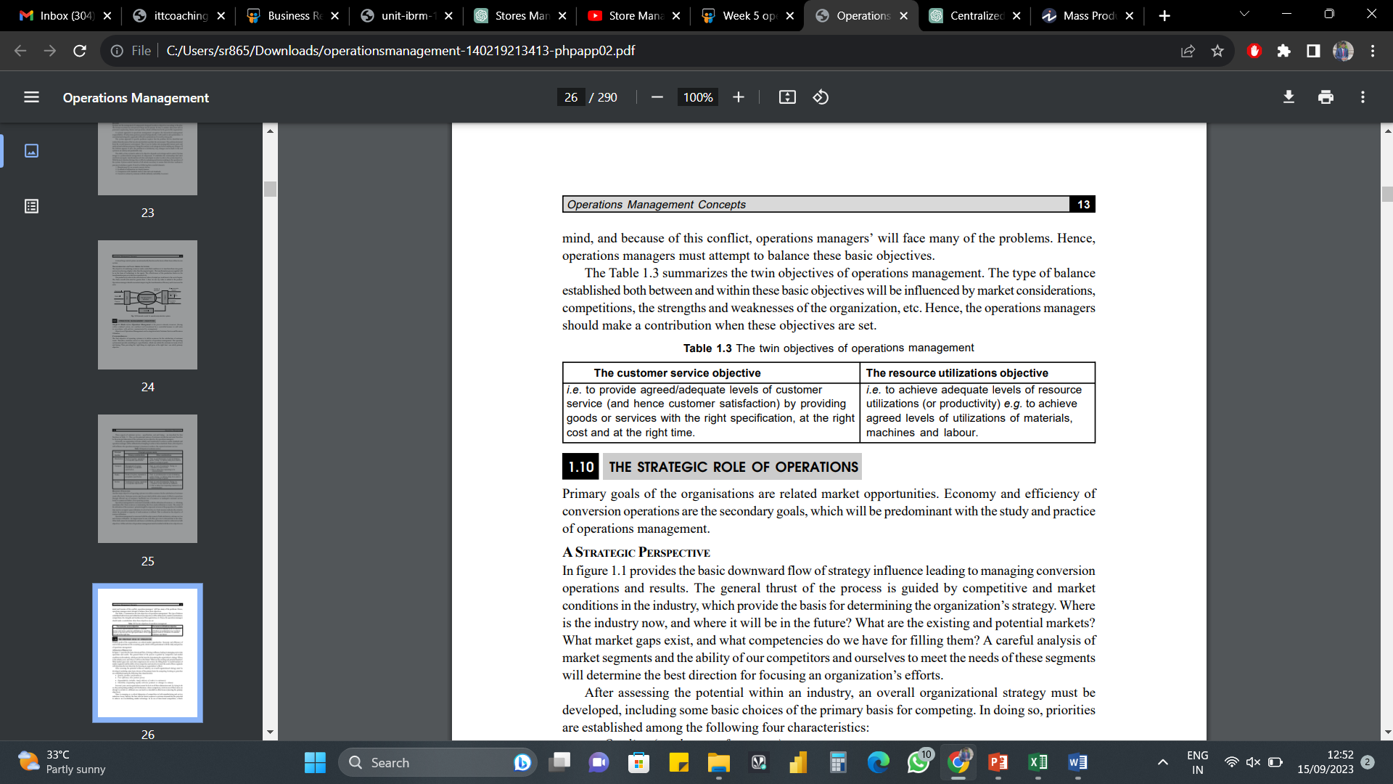
Objectives of Operations Management
The type of balance established both between and within these basic objectives will be influenced by market considerations, competitions, the strengths and weaknesses of the organization, etc. Hence, the operations managers should make a contribution when these objectives are set.

Slide 48
Key Functions of Operations Management
Finance
In any manufacturing organization, finance plays a crucial role in ensuring that financial resources are properly allocated and utilized to their full extent. Finance in operations management helps create a budget that will allow the organization to meet its production goals and can help evaluate various investment opportunities to make the best decision. Proper utilization and allocation of finances will allow for a product to be created for the lowest cost that will also satisfy overall consumer needs.

Slide 49
Key Functions of Operations Management
Strategy
Strategic management is the planning, monitoring, analysis and assessment of all aspects of an organization on a continuing basis. Attention to these elements ensures that a strategy is developed and then implemented in the manufacturing facility.

Slide 50
Key Functions of Operations Management
The benefits of strategic management will help manufacturing organizations make better decisions regarding production planning and scheduling, keep customers happy and allow the facility to meet its overall goals. Many business strategies include supply chain configuration, sales, capacity to hold money, and optimal utilization of human resources.

Slide 51
Key Functions of Operations Management
Operation
This function of operations management is concerned with planning, organizing, directing, and overall control of all activities within the organization. This is the primary function of operations management and will effectively aid in converting raw materials and human efforts into a durable good and service that consumers will be able to utilize.

Slide 52
Key Functions of Operations Management
Operations within production must be scheduled in a way that minimizes the amount of setup required and maximizes the utilization of resource capacity. If this is achieved, the production facility will be able to increase its production output.

Slide 53
Key Functions of Operations Management
Operations within production must be scheduled in a way that minimizes the amount of setup required and maximizes the utilization of resource capacity. If this is achieved, the production facility will be able to increase its production output.

Slide 54
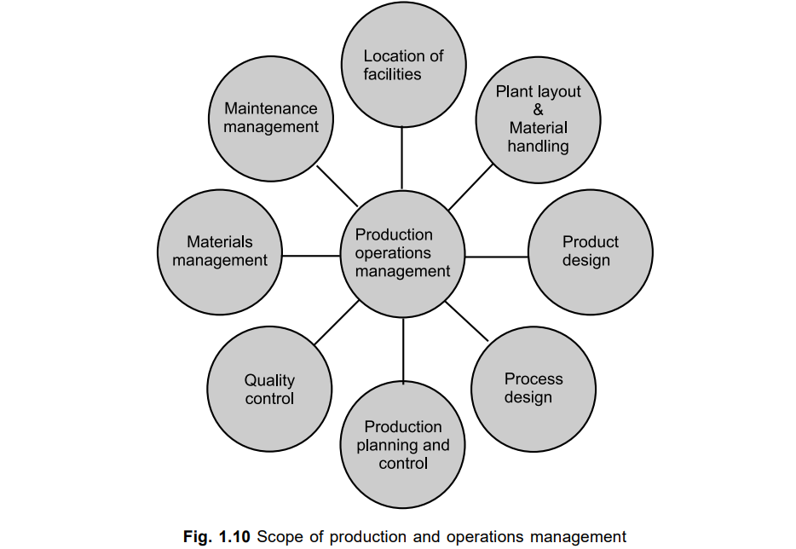
Scope of Operations Management
Following are the activities, which are listed under Production and Operations Management functions:

Slide 55
Scope of OM – Location of Facilities
Location of facilities for operations is a long-term capacity decision, which involves a long-term commitment about the geographically static factors that affect a business organisation. It is an important strategic level decision-making for an organisation. It deals with the questions such as ‘where our main operations should be based?’
The purpose of the location study is to find the optimal location that will results in the greatest advantage to the organization.

Slide 56
Scope of OM – Plant Layout & Material Handling
Plant layout refers to the physical arrangement of facilities. It is the configuration of departments, work centres and equipment in the conversion process. The overall objective of the plant layout is to design a physical arrangement that meets the required output quality and quantity most economically.

Slide 57
Scope of OM – Plant Layout & Material Handling
According to James More ‘Plant layout is a plan of an optimum arrangement of facilities including personnel, operating equipment, storage space, material handling equipments and all other supporting services along with the design of best structure to contain all these facilities’.

Slide 58
Scope of OM – Plant Layout & Material Handling
‘Material Handling’ refers to the ‘moving of materials from the store room to the machine and from one machine to the next during the process of manufacture’. It is also defined as the ‘art and science of moving, packing and storing of products in any form’. It is a specialized activity for a modern manufacturing concern, with 50 to 75% of the cost of production.

Slide 59
Scope of OM – Plant Layout & Material Handling
This cost can be reduced by proper section, operation and maintenance of material handling devices. Material handling devices increases the output, improves quality, speeds up the deliveries and decreases the cost of production. Hence, material handling is a prime consideration in the designing new plant and several existing plants.

Slide 60
Scope of OM – Product Design
Product design deals with conversion of ideas into reality. Every business organisation have to design, develop and introduce new products as a survival and growth strategy. Developing the new products and launching them in the market is the biggest challenge faced by the organizations.

Slide 61
Scope of OM – Product Design
The entire process of need identification to physical manufactures of product involves three functions— Design and Marketing, Product, Development and manufacturing. Product Development translates the needs of customers given by marketing into technical specifications and designing the various features into the product to these specifications.

Slide 62
Scope of OM – Product Design
Manufacturing has the responsibility of selecting the processes by which the product can be manufactured. Product design and development provides link between marketing, customer needs and expectations and the activities required to manufacture the product.

Slide 63
Scope of OM – Process Design
Process design is a macroscopic decision-making of an overall process route for converting the raw material into finished goods. These decisions encompass the selection of a process, choice of technology, process flow analysis and layout of the facilities.
Hence, the important decisions in process design are to analyse the workflow for converting raw material into finished product and to select the workstation for each included in the workflow.

Slide 64
Scope of OM – Production Planning & Control
Production planning and control can be defined as the process of planning the production in advance, setting the exact route of each item, fixing the starting and finishing dates for each item, to give production orders to shops and to follow-up the progress of products according to orders.
The principle of production planning and control lies in the statement ‘First Plan Your Work and then Work on Your Plan’.

Slide 65
Scope of OM – Production Planning & Control
Main functions of production planning and control include Planning, Routing, Scheduling, Dispatching and Follow-up.
Planning is deciding in advance what to do, how to do it, when to do it and who is to do it. Planning bridges the gap from where we are, to where we want to go. It makes it possible for things to occur which would not otherwise happen.

Slide 66
Scope of OM – Production Planning & Control
Routing may be defined as the selection of path, which each part of the product will follow, which being transformed from raw material to finished products. Routing determines the most advantageous path to be followed for department to department and machine to machine till raw material gets its final shape.

Slide 67
Scope of OM – Production Planning & Control
Scheduling determines the programme for the operations. Scheduling may be defined as 'the fixation of time and date for each operation' as well as it determines the sequence of operations to be followed.

Slide 68
Scope of OM – Production Planning & Control
Dispatching is concerned with the starting the processes. It gives necessary authority so as to start a particular work, which has been already been planned under ‘Routing’ and ‘Scheduling’. Therefore, dispatching is ‘Release of orders and instruction for the starting of production for any item in acceptance with the Route sheet and Schedule Charts’.

Slide 69
Scope of OM – Production Planning & Control
The function of Follow-up is to report daily the progress of work in each shop in a prescribed proforma and to investigate the causes of deviations from the planned performance.

Slide 70
Scope of OM – Quality Control
Quality Control may be defined as ‘a system that is used to maintain a desired level of quality in a product or service’. It is a systematic control of various factors that affect the quality of the product. Quality Control aims at prevention of defects at the source, relies on effective feedback system and corrective action procedure.

Slide 71
Scope of OM – Quality Control
Quality Control can also be defined as ‘that Industrial Management technique by means of which product of uniform acceptable quality is manufactured’. It is the entire collection of activities, which ensures that the operation will produce the optimum quality products at minimum cost.

Slide 72
Scope of OM – Quality Control
The main objectives of Quality Control are:
1. To improve the companies income by making the production more acceptable to the customers i.e. by providing longlife, greater usefulness, maintainability etc.
2. To reduce companies cost through reduction of losses due to defects.
3. To achieve interchangeability of manufacture in large-scale production.

Slide 73
Scope of OM – Quality Control
4. To produce optimal quality at reduced price.
5. To ensure satisfaction of customers with productions or services or high quality level, to build customer good will, confidence and reputation of manufacturer.
6. To make inspection prompt to ensure quality control.
7. To check the variation during manufacturing.

Slide 74
Scope of OM – Materials Management
Materials Management is that aspect of management function, which is primarily concerned with the acquisition, control, and use of materials needed and flow of goods and services connected with the production process having some predetermined objectives in view.
The main objectives of Material Management are:
1. To minimise material cost.

Slide 75
Scope of OM – Materials Management
2. To purchase, receive, transport and store materials efficiently and to reduce the related cost.
3. To cut down costs through simplification, standardisation, value analysis, import substitution, etc.
4. To trace new sources of supply and to develop cordial relations with them in order to ensure continuous supply at reasonable rates.
5. To reduce investment tied in the inventories for use in other productive purposes and to develop high inventory turnover ratios.

Slide 76
Scope of OM – Maintenance Management
In modern industry, equipment and machinery are a very important part of the total productive effort. Therefore their idleness or downtime becomes are very expensive. Hence, it is very important that the plant machinery should be properly maintained.
The main objectives of Maintenance Management are:
1. To achieve minimum breakdown and to keep the plant in good working condition at the lowest possible cost.

Slide 77
Scope of OM – Maintenance Management
2. To keep the machines and other facilities in such a condition that permits them to be used at their optimal capacity without interruption.
3. To ensure the availability of the machines, buildings and services required by other sections of the factory for the performance of their functions at optimal return on investment.

Slide 78
Roles & Responsibilities of an Operations Manager
The role of an Operations Manager encompasses several sets of responsibilities. These operations manager roles should be fulfilled for the successful functioning of an organization.
Roles of an Operations Manager
There are diverse operations manager roles, some of which are listed below:

Slide 79
Roles & Responsibilities of an Operations Manager
1. Process Optimization: Operations managers use process optimization techniques to enhance productivity. They identify bottlenecks and implement process improvements. Their aim is to design efficient systems to promote smooth operations.
2. Performance Tracking: Operational managers recognize the significance of KPIs. So, they track productivity, quality and efficiency to identify opportunities for growth.

Slide 80
Roles & Responsibilities of an Operations Manager
3. Team Leadership: Team leaders work to foster a collaborative work environment. It is achieved by delegating tasks, setting performance targets, and offering guidance.
4. Budget Management: Operations managers establish and administer budgets to control costs. They allocate funds among different departments, guaranteeing financial sustainability.

Slide 81
Roles & Responsibilities of an Operations Manager
5. Quality Control: Operations managers maintain high standards for product or service quality. They implement quality control measures to ensure products meet or exceed customer expectations.
6. Supply Chain Coordination: These professionals supervise the supply chain. They oversee inventory levels, procurement and distribution to prevent overstock situations.

Slide 82
Roles & Responsibilities of an Operations Manager
7. Crisis Management: Operations managers understand their responsibility when faced with challenges. Their role is to minimize disruptions in case something unexpected comes up.

Slide 83
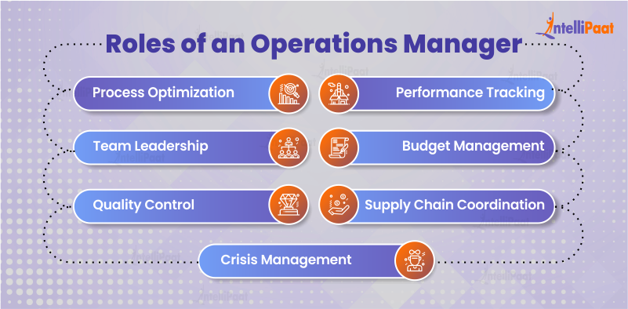
Roles & Responsibilities of an Operations Manager

Slide 84
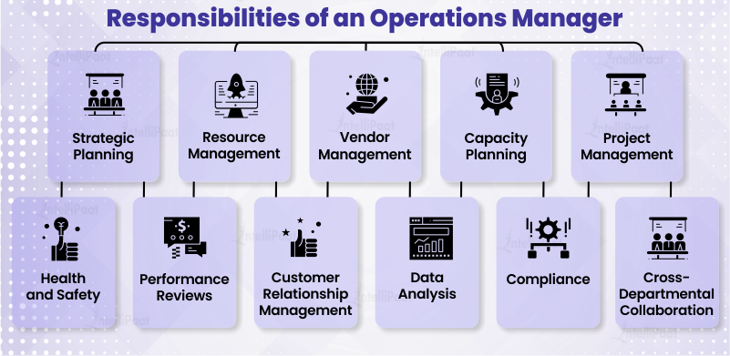
Roles & Responsibilities of an Operations Manager

Slide 86
Operations Management
.
Unit – II
Facility Location, Layout & Maintenance
Sai Ram B
Lecturer

Slide 87
Factors Affecting Facility Location
The pattern of layout varies from industry to industry, location to location, and plant to plant. Different types of layout are in use; and the selection of a particular type to suit the requirements of plant depends on a number of factors.
Primarily, the layout of the plant is influenced by the relationship among materials, machinery and men. Other factors – such as the type of product, type of workers, type of industry and management policies – also influence the layout.

Slide 88
Factors Affecting Facility Location - Materials
In certain manufacturing concerns which use heavy raw materials, as in the manufacture of road-rollers, heavy overhead cranes are required. Pipelines are used to transport iron ore, crude oil, wheat and salt. For example, a 67 km slurry pipeline carries iron ore from the Kudremukh Iron Ore Project to Mangalore Port. Gravity or airflow moves the materials ahead in the pipelines. Similarly, roller conveyors, belt conveyors, and chain conveyors are used to move materials during various stages of production. It is, therefore, essential that a plant layout should be planned after bearing in mind the particular handling or moving equipment which may be required in the manufacturing process.

Slide 89
Factors Affecting Facility Location - Materials
It is, therefore, essential that a plant layout should be planned after bearing in mind the particular handling or moving equipment which may be required in the manufacturing process.
The usual way of taking the raw material factor into account is to draw flow charts to. visualise the paths of materials flow or movements, and then to eliminate cross-covers, long distances and back tracking. The best path is thus determined, around which the layout is planned.

Slide 90
Factors Affecting Facility Location - Product
A layout is designed with the ultimate purpose of producing a product. The type of product - that is, whether the product is heavy or light, big or small, liquid or solid - and its position in relation to the plant location influence the layout.

Slide 91
Factors Affecting Facility Location - Product
ln a majority of cases, the product moves from work station to work station. In some cases, as in the manufacture of locomotives and in ship-building, the product is stationary; but machinery and men are moved to the product. Thus, the position of the product in relation to the other factors of production deserves consideration in planning a layout. In the same way, the size of the product should be considered in planning the layout of a plant.

Slide 92
Factors Affecting Facility Location - Product
The requirements of a layout meant for a heavy product are different from the requirements form the requirements of that for a light product. Again, the layout requirements for assembling a watch are different from those for the assembly of an aeroplane. The manufacture of certain products involves wet operations, as in leather tanning or textile dyeing.

Slide 93
Factors Affecting Facility Location - Product
The requirements of a layout meant for a heavy product are different from the requirements form the requirements of that for a light product. Again, the layout requirements for assembling a watch are different from those for the assembly of an aeroplane. The manufacture of certain products involves wet operations, as in leather tanning or textile dyeing.

Slide 94
Factors Affecting Facility Location - Product
A plant layout must be the expression of a purpose. This purpose is the efficient and effective production of a product or product line. The purpose then dictates that the point at which the analyst for layout must start is with the product to be produced.

Slide 95
Factors Affecting Facility Location - Worker
The layout designer should also consider the type, position and requirements of employees. If women workers are employed, the layout must be planned after keeping in mind their particular requirements. The position of employees, that is, whether they remain stationary or moving, also influences the layout.
Employee facilities, such as health and related services, feeding and related services, locker rooms and lavatories influence the layout significantly. Employee safety, too, must receive due consideration.

Slide 96
Factors Affecting Facility Location - Machinery
The type of product, the volume of its production, the type of process and management policy determines the size and type of the machinery to be installed which, in turn, influences the plant layout. Production is the combination and manipulation of men, materials and machines. These elements may be combined in various ratios and in various ways in the course of the production activity. The ratio in which these elements are used depends on their relative costs and on the production processes selected.

Slide 97
Factors Affecting Facility Location - Machinery
Before laying out a plant, it is necessary to determine which of these elements are to be stationary or fixed as to location in the plant and which will be mobile during the process of production. Various alternatives are available in determining which factor to move:
To move the product and the workers from work station to work station.
To move the product from work station to work station, keeping the machines and workers stationary.

Slide 98
Factors Affecting Facility Location - Machinery
(c) To move the worker and the machine to the product, which is held at the location. used in a plant.
The layout or arrangement of machines should be planned to suit the alternative
exercise a significant influence on plant layout.

Slide 99
Factors Affecting Facility Location – Type of Industry
The type of industry and the method of the manufacturing process exercise a significant influence on plant layout.
Industries in this context may be broadly classified into four types:
A. Synthetic
B. Analytical
C. Conditioning
D. Extractive

Slide 100
Factors Affecting Facility Location – Type of Industry
Extractive industries involve the separation of one element from another, as in the case of metal from the ore. A conditioning industry involves a change form or physical properties. Metal working industries, foundries, and leather tanning concerns condition their raw materials to have the end products. An analytical industry converts raw materials into various elements or constituent parts.
An oil refinery, for example, yields naphtha, gasoline, paraffin, tar and kerosene.

Slide 101
Factors Affecting Facility Location – Type of Industry
Similarly, a sugar mill gives, besides sugar, bagasse and molasses. A synthetic industry also called as assembling industry, involves the production of a product by the use of various elements. In other words, various elements go into the manufacture of an end-product.
The chemical industry and the paper industry are synthetic industries. Light and heavy engineering and watch-making industries, in which several components are assembled to get the final products, also fall under synthetic industries.

Slide 102
Factors Affecting Facility Location – Type of Industry
Each of the above types of industries may be further classified into two types, namely,
(a) Intermittent industries and
(b) Continuous industries.
This classification is based on the method of manufacture. The former type of industries manufacture different components on different machines and assemble them to get end-products.

Slide 103
Factors Affecting Facility Location – Type of Industry
Continuous industries uninterruptedly produce one or two products of a standardised It is needless to emphasise that the layout designer should keep in mind the type of industry and the method of the manufacturing process while planning a layout.

Slide 104
Factors Affecting Facility Location – Location
The site selected for the location of a plant influences its layout in more than one way. First, the size and the terrain of the site determine the type of building which, in turn, influences the layout. Second, the location of the plant determines the mode of transportation, depending upon the distances from the source of raw materials and market to the plant.

Slide 105
Factors Affecting Facility Location – Location
In some cases, railroads are used, in some others trucks are used. In a few cases, water loading and unloading facilities are required. The layout plan should provide for the exact type of transportation required. Third, a plant location may be determined in part by the fuel requirements of the concern. The plant layout must provide for the storage of this fuel, whether it be coal, oil or gas. Also, the layout must consider the requirements of power generation. Fourth, the demand for future expansion influences the plant layout.

Slide 106
Factors Affecting Facility Location – Location
If a village site is selected, expansion may be effected by adding one more wing to the existing single-storey construction. If an urban site is selected, expansion may be effected by adding more storeys to the present structures. The number of storeys determines the type of materials handling equipment which would be required and which, in turn, influences the plant layout.

Slide 107
Factors Affecting Facility Location – Managerial Policies
Management policies significantly influence plant layout. The following are such managerial policies:
(a) The volume of production and provision for expansion;
(b) The extent of automation;
(C) Making or buying a particular component;
(d) Desire for rapid delivery of goods to customers;
(e) Purchasing policy;
(f) Personnel policies.

Slide 108
Factors Affecting Facility Location – Managerial Policies
It is obvious that many top management policies determine the plant layout objectives and the scope of the plant activities. The layout engineer must have clear and complete understanding of those top management policies that have a bearing on plant layout objectives.

Slide 109
Principles of Facility Layout
The factors discussed above influence the choice of a particular type of layout. While accepting the selected layout, the layout engineer should be guided by certain principles. The layout selected in conformity with layout principles should be an ideal one. These principles are:

Slide 110
Principles of Facility Layout
Principle of Minimum Travel
Men and materials should travel the shortest distance between operations so as to avoid waste of labour and time and minimise the cost of materials handling.
Principle of Sequence
Machinery and operations should be arranged in a sequential order. This principle is best achieved in product layout, and efforts should be made to have it adopted in the process layout.

Slide 111
Principles of Facility Layout
Principle of Usage
Every foot of available space should be effectively utilised. This principle should receive top consideration in towns and cities where land is costly.
Principle of Compactness
There should be a harmonious fusion of all the relevant factors so that the final layout looks well integrated and compact.

Slide 112
Principles of Facility Layout
Principle of Safety and Satisfaction
The layout should contain built in provisions for safety for the workmen. It should also be planned on the basis of the comfort and convenience of the workmen so that they feel satisfied.
Principle of Flexibility
The layout should permit revisions with the least difficulty and at minimum cost.

Slide 113
Principles of Facility Layout
Principle of Minimum Investment
The layout should result in savings in fixed capital investment, not by avoiding installation of the necessary facilities but by an intensive use of available facilities.

Slide 114
Classification of Plant Layouts
A layout essentially refers to the arranging and grouping of machines which are meant to produce goods. Grouping is done on different lines. The choice of a particular line depends on several factors. The methods of grouping or the types of layout are:
(i) Process layout or Functional layout or Job Shop layout;
(ii) Product layout or Line Processing layout or Flow-line layout;
(iii) Fixed position layout or static layout;
(iv) Cellular Manufacturing (CM) layout or Group Technology layout;
(v) Combination layout or Hybrid layout.

Slide 115
Process Layout or Job-Shop Layout
This process layout involves a grouping together of like machines in one department. e.g., machines performing drilling operations are fixed in the drilling department; machines performing casting operations are grouped in the casting department; and so on. In this way, there would be a heating department, a painting department, where similar machines are installed in the plants which follow the process layout. The process arrangement is signified by the grouping together of like machines based upon their operational characteristics.

Slide 116
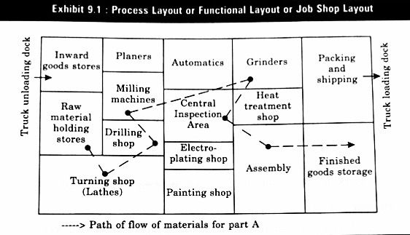
Process Layout or Job-Shop Layout
T

Slide 117
Process Layout or Job-Shop Layout
A quantity of raw material is issued to a machine which performs first operation. This machine may be situated anywhere in the factory. For the next operation, a different machine may be required, which may be situated in another part of the factory. The material is transported to this other machine for treatment. Thus, material would move long distances and along crisscrossing paths.

Slide 118
Process Layout or Job-Shop Layout
At one stage, the material may be taken to a separate building say, for heat treatment and then brought back for grinding. If machines in one department are engaged, the partly finished product awaiting operations may be taken to the store and later reissued for production. Partly finished goods would be waiting for treatment in every department, like commuters waiting for buses in a city.
While grouping machines according to the process type, certain principles must be kept in mind. These are:

Slide 119
Process Layout or Job-Shop Layout
(i) The distance between departments needs to be as short as possible with a view to avoiding long-distance movement of materials.
(ii) Though, like machines are grouped in one department, the departments themselves should be located in accordance with the principle of sequence of operations. For example, in a steel plant, the operations are melting, casting, rolling and twisting. These different departments may be arranged in that order to avoid crossovers and backtracking of materials.
(iii) Convenience for inspection
(iv) Convenience for supervision.
Process layout may be advantageously used in light and heavy engineering industries, made-to-order furniture industries and the like.

Slide 120
Process Layout or Job-Shop Layout - Advantages
1. Reduced investment of machines as they are general purpose machines.
2. Greater flexibility in the production.
3. Better and more efficient supervision is possible through specialisation.
4. There is greater scope for expansion as the capacities of different lines can be easily increased.
5. This type of layout results in better utilization of men & machines.

Slide 121
Process Layout or Job-Shop Layout - Advantages
6. It is easier to handle breakdown of equipment by transferring work to another machine or station.
7. There is full utilisation of equipment.
8. The investment of equipment would be comparatively lower.
9. There is greater incentive to individual worker to increase his performance.

Slide 122
Process Layout or Job-Shop Layout - Disadvantages
1. There is difficulty in the movement of materials. Mechanical devices for handling materials can not be conveniently used.
2. This type of layout requires more floor space.
3. There is difficulty in production control.
4. Production time is more as work-in-progress has to travel from place to place in search of machines.
5. There is accumulation of work-in-progress at different places.

Slide 123
Product Layout or Line Layout
This involves the arrangement of machines in one line, depending upon the sequence of operations.
Material are fed into the first machine and finished products come out of the last machine. In between, partly finished goods travel automatically, from machine to machine, the output of one machine becoming the input for the next. It is a feast for the eyes to watch the way sugarcane, fed at one and of the mill, comes out as sugar the other end. Similarly, in paper mill, bamboos are fed into the machine at one end and paper comes out at the other end.

Slide 124
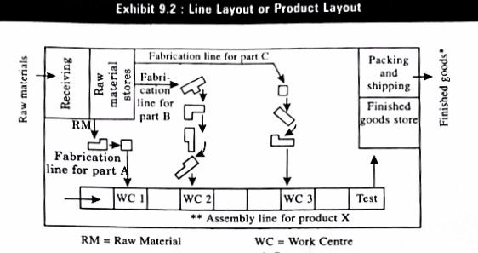
Product Layout or Line Layout
.

Slide 125
Product Layout or Line Layout
In product layout, if there are more than one line of production, there are as many lines of machines. The emphasis therefore, is on special purpose machines in contrast to general purpose machines, which are installed in the process layout. Consequently, the investment on machines in a straight line layout is higher than the investment on machines in a functional layout.
The grouping of machines should be done, on product line, keeping in mind the following principles:

Slide 126
Product Layout or Line Layout
(i) All the machine tools or other items of equipment must be placed at the point demanded by the sequence of operations.
(ii) There should be no points where one line crosses another line.
(iii) Materials may be fed where they are required for assembly, but, not necessarily all at one point.
(iv) All the operations, including assembly, testing and packing should be included in the line.
The product layout may be advantageously followed in plants manufacturing standardised products on a mass scale such as chemical, paper, sugar, rubber and cement industries.

Slide 127
Product Layout or Line Layout - Advantages
1. There is mechanisation of materials handling and consequently reduction in materials handling cost.
2. This type of layout avoids production bottlenecks.
3. There is economy in manufacturing time.
4. This type of layout facilitates better production control.
5. This type of layout requires less floor area per unit of production.
6. Work-in-progress is reduced and investment thereon is minimised.
7. Early detection of mistakes or badly produced item is possible.

Slide 128
Product Layout or Line Layout - Disadvantages
1. Product layout is known for its inflexibility.
2. This type of layout is also expensive.
3. There is difficulty of supervision.
4. Expansion is also difficult.
5. Any breakdown of equipment along a production line can disrupt the whole system.

Slide 129
Fixed Position Layout or Static Layout
As the term itself implies, the fixed position layout involves the movement of men and machines to the product which remains stationary. In this type of layout, the material or major component remains in a fixed location and tools, machinery and men as well as other pieces of material are brought to this location. The movement of men and machines to the product is advisable because the cost of moving them would be less than the cost of moving the product which is very bulky.

Slide 130
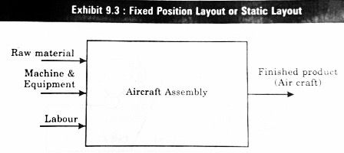
Fixed Position Layout or Static Layout
.

Slide 131
Fixed Position Layout or Static Layout
This type is followed in the manufacture of bulky and heavy products, such as locomotives, ships, boilers, aircrafts and generators. The construction of a building requires a fixed location layout because men, cement, sand, bricks, steel, wood and others are taken to the site of the construction. This is equally true of a brick kiln. Another example is that of a hospital, where doctors and nurses (workers) and medicines and other paraphernalia (materials) are taken to the patient (product).

Slide 132
Fixed Position Layout or Static Layout - Advantages
(i) Men and machines can be used for a wide variety of operations producing different products.
(ii) The investment on layout is very small.
(iii) The worker identifies himself with the product and takes pride in it when the work is complete.
(iv) The high cost of, and difficulty in transporting a bulky product are avoided.

Slide 133
Cellular Manufacturing Layout
In Cellular Manufacturing (CM), machines are grouped into cells function somewhat like a product layout within a larger shop or process layout. Each cell in CM layout is formed to produce a single parts family – a few parts, all with common characteristics, which usually means that they require the same machines and have similar machine settings.

Slide 134
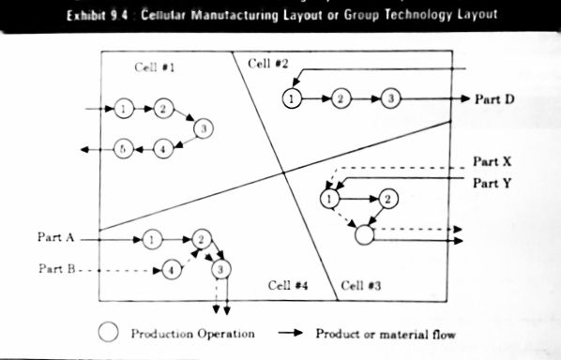
Cellular Manufacturing Layout
.

Slide 135
Cellular Manufacturing Layout
The flow of parts with in cells, can take many forms. For example, in cells #1 and #2, the parts in the part family flow through the same machines in a product focused, line flow fashion. But in the cells #3 and #4, parts take different routes through the cells because of the differences between the designs of the two parts.

Slide 136
Cellular Manufacturing Layout
Among the advantages of cellular layouts are lower work-in-process inventories, reduced materials handling costs, shorter flow times in production, simplified production planning (materials and labour), increased operator responsibilities, improved visual control and fewer tooling changes therefore facilitating quicker setups. Overall performance often increases by lowering production costs and improving on time delivery. Quality also tends to improve.

Slide 137
Cellular Manufacturing Layout
Disadvantages include reduced manufacturing flexibility and potentially increased machine-down time (since machines are contained to cells and may not be used all the time) and finally duplicate pieces of equipment may be needed so that parts need not be transported between cells.

Slide 138
Combined Layout or Hybrid Layout
The application of the principles of product layout, process layout or fixed location layout in their strict meanings is difficult to come across. A combination of the product and process layouts, with an emphasis on either, is noticed in most industrial establishments. Plants are never laid out in either pure form. It is possible to have both types of layout in an efficiently combined form if the products manufactured are somewhat similar and not complex.

Slide 139
Combined Layout or Hybrid Layout
In plants involving the fabrication of parts and assembly, fabrication tends to employ the process layout, while the assembly areas often employ the product layout.
In soap manufacturing plants, the machinery manufacturing soap is arranged on the product-line principle; but ancillary services, such as heating, the manufacturing of glycerine, the power-house, the water treatment plant are arranged on a functional basis.

Slide 140
Combined Layout or Hybrid Layout
To extend the logic of the combined layout, we may refer to the application of the fixed location principle in every industrial establishment. Is it not true that workers are brought from different places in buses to the factory every day? Will not materials and tools be carried to the place of manufacture every time?

Slide 141
Combined Layout or Hybrid Layout
To sum up, In the final analysis, the combination that produces the desired volume of products at the least total cost is preferred. Marketing is concerned with maximising income, industrial engineering is concerned with minimising cost and management is gambling that there is a sufficient difference in its favour.

Slide 142
Maintenance Management
Maintenance - It is defined as "that function of production management that is concerned with day-to-day problem of keeping the physical plant in good operating condition. It is an essential activity in every manufacturing firm, because it is necessary to ensure the availability of the machines, buildings and services needed by other parts of the organization for the performance of their function at an optimum return on investment in machines, materials and men”.

Slide 143
Maintenance Management
Maintenance management is concerned with the direction and organization of resources in order to control the availability and performance of the industrial plants to some specified level. It is a function supporting production function and is entrusted with the task of keeping the machinery, equipment and plant services in proper working condition. It also involves maintenance planning, maintenance scheduling, execution of maintenance activities (repair, breakdown and preventive maintenance) and controlling costs of maintenance.

Slide 144
Maintenance Management - Functions
Maintenance of existing plant and equipment.
Maintenance of existing plant buildings and grounds.
Equipment inspection and lubrication.
Utilities generation and distribution.
Alterations to existing equipment and buildings.
New installations of equipment and buildings.

Slide 145
Types of Maintenance
Organizations may use several type of maintenance in different type of situations. The following are the types of maintenance which typically followed by the organizations.
Break-down or Corrective Maintenance
Preventive Maintenance
Predictive Maintenance
Routine Maintenance
Planned Maintenance

Slide 146
Importance of Maintenance Management
1. Dependability of service is one of the performance measures by which a company can distinguish itself from others. To establish a competitive edge and to provide good customer service, companies must have reliable equipment that will respond to customer demand when needed. Equipment must be kept in reliable condition without costly work stoppage and down time due to repairs if the company is to remain productive and competitive.

Slide 147
Importance of Maintenance Management
2. Maintenance is an important factor in quality assurance which is another basis for successful competitive edge. Inconsistencies in equipment leads to variability in product characteristics and result in defective parts that fail to meet the established specifications. Beyond just preventing break downs, it is necessary to keep equipment operating within specifications (i.e., process capability) that will produce high level of quality.

Slide 148
Importance of Maintenance Management
3. Many manufacturing organizations, particularly those with JIT Just-In-Time) programs are operating with inventories so low that they offer no protection in the event of a lengthy equipment failure. Beyond the cost of idle equipment, idle labour and lost sales that can result from a breakdown, there is a danger of permanently losing market shares to companies that are more reliable. Maintenance function can help prevent such an occurrence.

Slide 149
Importance of Maintenance Management
4. Good maintenance management is important for the company's cost control. As companies go in for automation to become more competitive, they increasingly rely on equipment to produce a greater percentage of their output. It becomes more important that equipment operate reliably within specifications. The cost of idle time is higher as equipment becomes more high-tech and expensive, e.g., NC/CNC machines and robots.

Slide 150
Importance of Maintenance Management
5. Organisations like airlines and oil refineries have huge investment in equipment. Equipment failure will be disastrous for such companies. They need proper maintenance to maintain equipment in good condition.

Slide 152
Operations Management
.
Unit – III
Capacity Planning & Materials Management
Sai Ram B
Lecturer

Slide 153
Capacity Planning
The objective of capacity management (i.e. planning and control of capacity) is to match the level of operations to the level of demand. Capacity planning is to be carried out keeping in mind future growth and expansion plans, market trends, sales forecasting etc.
It is a simple task to plan the capacity in case of stable demand. But, in practice the demand will be seldom stable. The fluctuation of demand creates problems regarding the procurement of resources to meet the customer demand.

Slide 154
Capacity Planning
Capacity decisions are strategic in nature. Capacity is the rate of productive capability of a facility. Capacity is usually expressed as volume of output per period of time. Production managers are more concerned about the capacity for the following reasons:
Sufficient capacity is required to meet the demand in time.
Capacity affects the cost efficiency of operations.
Capacity affects the scheduling system.
Capacity creation requires an investment.
Capacity planning is the first step when an organization decides to produce more or new products.

Slide 155
Process of Capacity Planning
Capacity planning is concerned with defining the long-term and the short-term capacity needs of an organization and determining how those needs will be satisfied. Capacity planning decisions are taken based upon the consumer demand and this is merged with the human, material and financial resources of the organization.
Capacity requirements can be evaluated from two perspectives, long-term capacity strategies and short-term capacity strategies.

Slide 156
Process of Capacity Planning – Long-term Strategies
Long-term capacity requirements are more difficult to determine because the future demand and technology are uncertain. Forecasting for five or ten years into the future is more risky and difficult. Even sometimes company’s current products may not be existing in the future. Long-range capacity requirements are dependent on marketing plans, product development and life-cycle of the product.

Slide 157
Process of Capacity Planning – Long-term Strategies
Long-term capacity planning is concerned with accommodating major changes that affect overall level of the output in long-term. Marketing environmental assessment and implementing the long-term capacity plans in a systematic manner are the major responsibilities of management.
Following parameters will affect long-range capacity decisions.

Slide 158
Process of Capacity Planning – Long-term Strategies
Multiple Products
Company’s produce more than one product using the same facilities in order to increase the profit. The manufacturing of multiple products will reduce the risk of failure. Having more than on product helps the capacity planners to do a better job. Because products are in different stages of their life cycles, it is easy to schedule them to get maximum capacity utilization.

Slide 159
Process of Capacity Planning – Long-term Strategies
Phasing in Capacity: In high technology industries, and in industries where technology developments are very fast, the rate of obsolescence is high. The products should be brought into the market quickly. The time to construct the facilities will be long and there is no much time, as the products should be introduced into the market quickly. Here the solution is phase in capacity on modular basis. Some commitment is made for building funds and men towards facilities over a period of 3-5 years. This is an effective way of capitalizing on technological breakthrough.

Slide 160
Process of Capacity Planning – Long-term Strategies
Phasing out Capacity
The outdated manufacturing facilities cause excessive plant closures and down time. The impact of closures is not limited to only fixed costs of plant and machinery. Thus, the phasing out here is done with humanistic way without affecting the community. The phasing out options makes alternative arrangements for men like shifting them to other jobs or to other locations, compensating the employees etc.

Slide 161
Process of Capacity Planning – Short-term Strategies
Managers often use forecasts of product demand to estimate the short-term workload the facility must handle. Managers looking ahead up to 12 months, anticipate output requirements for different products and services. Managers then compare requirements with existing capacity and then take decisions as to when the capacity adjustments are needed.

Slide 162
Process of Capacity Planning – Short-term Strategies
For short-term periods of up to one year, fundamental capacity is fixed. Major facilities will not be changed. Many short-term adjustments for increasing or decreasing capacity are possible. The adjustments to be required depend upon the conversion process like whether it is capital intensive or labor intensive or whether product can be stored as inventory.

Slide 163
Process of Capacity Planning – Short-term Strategies
Capital-intensive processes depend on physical facilities, plant and equipment. Short-term capacity can be modified by operating these facilities more or less intensively than normal. In labor intensive processes short-term capacity can be changed by laying off or hiring people or by giving overtime to workers. The strategies for changing capacity also depend upon how long the product can be stored as inventory.

Slide 164
Process of Capacity Planning – Short-term Strategies
The short-term capacity strategies are:
Inventories: Stock finished goods during slack periods to meet the demand during peak period.
Backlog: During peak periods, the willing customers are requested to wait and their orders are fulfilled after a peak demand period.
Employment level (hiring or firing): Hire additional employees during peak demand period and lay-off employees as demand decreases.

Slide 165
Process of Capacity Planning – Short-term Strategies
Employee training: Develop multi skilled employees through training so that they can be rotated among different jobs. The multi skilling helps as an alternative to hiring employees.
Subcontracting: During peak periods, hire the capacity of other firms temporarily to make the component parts or products.
Process design: Change job contents by redesigning the job.

Slide 166
Capacity Decision
In Operations Management, Capacity Decisions are crucial for organizations to meet demand efficiently while managing resources effectively. Capacity refers to the maximum output or production capability of a process, facility, or system over a specific period. Capacity decisions involve determining the level of capacity needed to meet current and future demand.

Slide 167
Importance of Capacity Decisions
1. Capacity decisions have a real impact on the ability of the organization to meet future demands for products and services; capacity essentially limits the rate of output possible. Having capacity to satisfy demand can allow a company to take advantage of tremendous opportunities.

Slide 168
Importance of Capacity Decisions
2. Capacity decisions affect operating costs. Ideally, capacity and demand requirements will be matched, which will tend to minimize operating costs. In practice, this is not always achieved because actual demand either differs from expected demand or tends to vary (e.g., cyclically). In such cases, a decision might be made to attempt to balance the costs of over and under capacity.

Slide 169
Importance of Capacity Decisions
3. Capacity is usually a major determinant of initial cost. Typically, the greater the capacity of a productive unit, the greater its cost. This does not necessarily imply a one for-one relationship; larger units tend to cost proportionately less than smaller units.
4. Capacity decisions often involve long-term commitment of resources and the fact that, once they are implemented, it may be difficult or impossible to modify those decisions without incurring major costs.

Slide 170
Importance of Capacity Decisions
5. Capacity decisions can affect competitiveness. If a firm has excess capacity, or can quickly add capacity, that fact may serve as a barrier to entry by other firms. Then too, capacity can affect delivery speed, which can be a competitive advantage.
6. Capacity affects the ease of management; having appropriate capacity makes management easier than when capacity is mismatched.

Slide 171
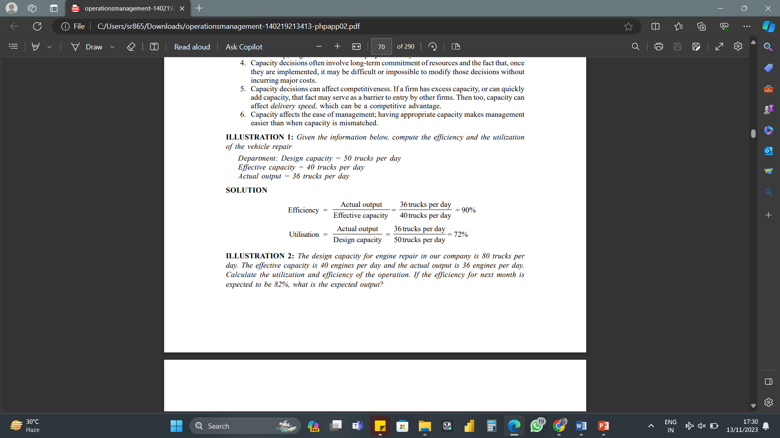
Importance of Capacity Decisions

Slide 172
Principles of Material Handling
The goal of material handling operations is to improve efficiency, productivity, safety, and profitability while reducing costs and waste.
To achieve these goals, there are ten principles of material handling that everyone involved in the process should follow, whether reviewing existing methods or looking at new processes. They include:

Slide 173
Principles of Material Handling - Planning
The planning principle involves identifying the materials that need to be moved, determining the best way to move them, and ensuring that the process is safe and efficient. When using the planning principle to assess a material handling task, ask yourself the following questions:
What materials need to be moved?
What is the best way to move the materials?
How can the process be made safer and more efficient?

Slide 174
Principles of Material Handling - Standardization
The standardization principle involves using the same processes and material handling equipment for similar tasks to reduce variability and improve efficiency. When considering standardization, ask yourself:
Are there any similar tasks that can use the same processes and material handling equipment?
Can standardization reduce variability and improve efficiency?

Slide 175
Principles of Material Handling - Work
This involves minimizing the amount of physical work required within material handling systems to move materials by using equipment and automation, rather than pushing the limits of human capabilities. When considering the work principle, ask yourself:
Can equipment or automation reduce the physical work required?
How can the process be made less physically demanding?
Putting stress and strain on people only creates risk, so reducing manual handling helps to protect the workforce, keeping them safe, but also empowers them to be more efficient.

Slide 176
Principles of Material Handling - Ergonomics
The Ergonomic principle involves designing workstations and material handling equipment to minimize physical strain and fatigue. When considering ergonomics, ask yourself:
Is the equipment designed to minimize physical strain and fatigue?
Are workstations designed to minimize physical strain and fatigue?
When designing material handling equipment, to ensure our electric tugs and tows are easy to use for safe and effective operations.

Slide 177
Principles of Material Handling – Unit Load
Looking at Unit loads involves consolidating materials into a single load for more efficient movement, to maximize physical material flow. When considering the unit load principle, ask yourself:
Can materials be consolidated into a single load?
Can unit loads be standardized for more efficient movement?
Tugger trains of trolleys, platforms or dollies are often a good way to way to move more material in one go, reducing total trips or the number of times a task is carried out.

Slide 178
Principles of Material Handling – Space Utilization
The Space Utilization principle involves maximizing the use of available space for handling and storage activities. Warehouse space is often at a premium - even in terms of overhead space - and the same is true in manufacturing environments. When considering space utilization, ask yourself:
Can the available space be better utilized for storage and movement?
How can the available space be maximized for material handling?

Slide 179
Principles of Material Handling – System
The Systems principle involves using a coordinated system of processes, equipment, and people to improve material flow, improve operational efficiency and reduce waste. When considering the system principle, ask yourself:
Are there a coordinated system of processes, equipment & people?
Can the system be improved to reduce waste & improve efficiency?
A coordinated system is essential to ensure material handling processes, and the wider operation, runs smoothly.

Slide 180
Principles of Material Handling – Automation
The Automation principle involves using technology to automate material movement for improved efficiency and safety. When considering automation in material handling systems, ask yourself:
Can technology be used to automate material handling processes?
How can automation improve efficiency and safety?
Ultimately, if a material handling task is being repeated often, and especially where it involves regular travel times, AGV solutions could be the answer.

Slide 181
Principles of Material Handling – Environment
This involves considering the impact of material handling processes and material handling systems on the environment and taking steps to reduce waste and improve sustainability. When considering the environment, ask yourself:
What is the impact of a material handling process on the environment?
How can material handling systems be made more sustainable?

Slide 182
Principles of Material Handling – Life Cycle Cost
The Life Cycle Cost principle involves considering the total cost of material handling processes, including material handling equipment and time to run them. When considering the entire life cycle cost of material movement processes, ask yourself:
What is the total cost of material handling processes over the life of the equipment and processes?
How can cost be reduced through better equipment and process selection?
Sacrificing productivity by not investing in the right equipment and processes will only have a negative impact ultimately.

Slide 183
Principles of Material Handling
Following these ten principles of material handling can have several benefits for businesses, helping them to:
Improve Operational Efficiency
Maximize Workplace Safety
Reduce Costs and Waste
Improve Sustainability

Slide 184
Material Management
Materials management is a function, which aims for integrated approach towards the management of materials in an industrial undertaking. Its main objective is cost reduction and efficient handling of materials at all stages and in all sections of the undertaking. Its function includes several important aspects connected with material, such as, purchasing, storage, inventory control, material handling, standardization etc.

Slide 185
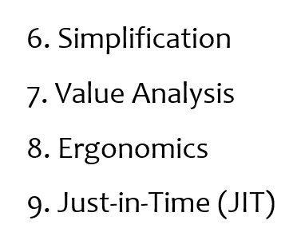
Functions of Material Management
From the definition it is clear that the scope of materials management is vast. The functions of materials management can be categorized in the following ways:
1. Material Planning and Control
2. Purchasing
3. Stores Management
4. Inventory Control or Management
5. Standardization

Slide 186
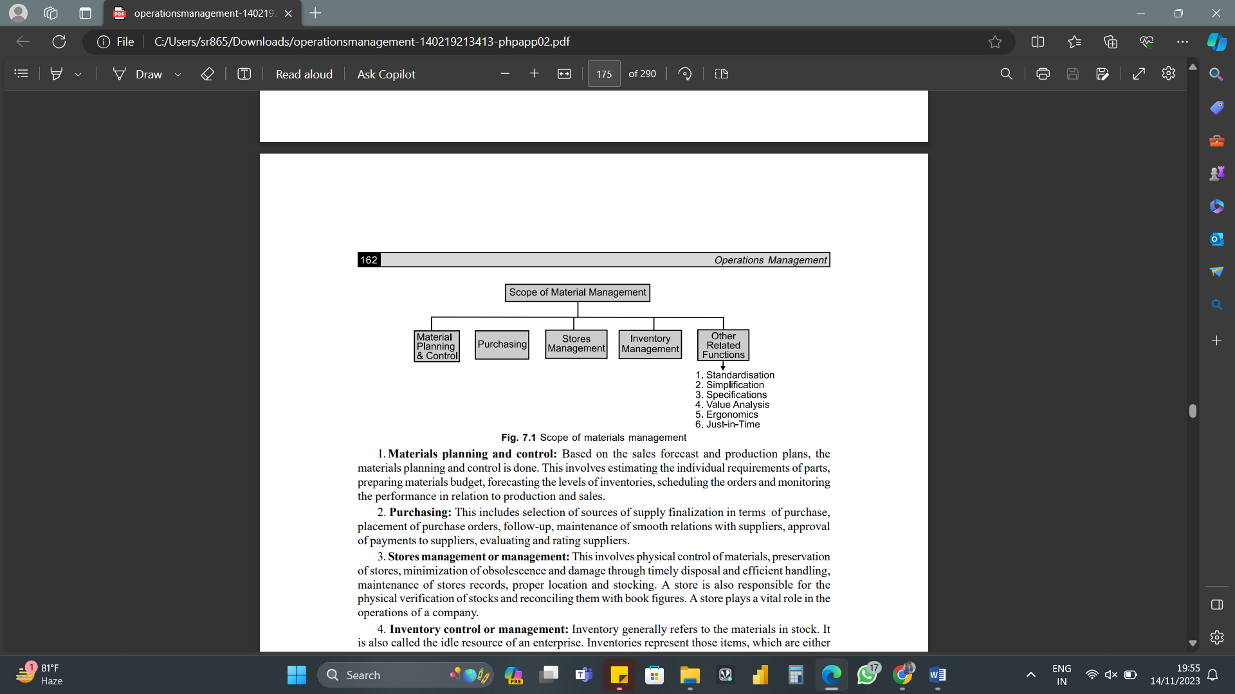
Functions of Material Management
Functions of Material Management

Slide 187
Functions of Material Management
Materials Planning and Control
Based on the sales forecast and production plans, the materials planning and control is done. This involves estimating the individual requirements of parts, preparing materials budget, forecasting the levels of inventories, scheduling the orders and monitoring the performance in relation to production and sales.

Slide 188
Functions of Material Management
Purchasing
This includes selection of sources of supply finalization in terms of purchase, placement of purchase orders, follow-up, maintenance of smooth relations with suppliers, approval of payments to suppliers, evaluating and rating suppliers.

Slide 189
Functions of Material Management
Stores Management
This involves physical control of materials, preservation of stores, minimization of obsolescence and damage through timely disposal and efficient handling, maintenance of stores records, proper location and stocking. A store is also responsible for the physical verification of stocks and reconciling them with book figures. A store plays a vital role in the operations of a company.

Slide 190
Functions of Material Management
Inventory Control or Management
Inventory generally refers to the materials in stock. It is also called the idle resource of an enterprise. Inventories represent those items, which are either stocked for sale or they are in the process of manufacturing or they are in the form of materials, which are yet to be utilized. The interval between receiving the purchased parts and transforming them into final products varies from industries to industries depending upon the cycle time of manufacture.

Slide 191
Functions of Material Management
Inventory Control or Management
It is, therefore, necessary to hold inventories of various kinds to act as a buffer between supply and demand for efficient operation of the system. Thus, an effective control on inventory is a must for smooth and efficient running of the production cycle with least interruptions.

Slide 192
Functions of Material Management
Standardization
Standardization means producing maximum variety of products from the minimum variety of materials, parts, tools and processes. It is the process of establishing standards or units of measure by which extent, quality, quantity, value, performance etc. may be compared and measured.

Slide 193
Functions of Material Management
Simplification
The concept of simplification is closely related to standardization. Simplification is the process of reducing the variety of products manufactured. Simplification is concerned with the reduction of product range, assemblies, parts, materials and design.
Specification
It refers to a precise statement that formulizes the requirements of the customer. It may relate to a product, process or a service.

Slide 194
Functions of Material Management
Value Analysis
Value analysis is concerned with the costs added due to inefficient or unnecessary specifications and features. It makes its contribution in the last stage of product cycle, namely, the maturity stage. At this stage, research and development no longer make positive contributions in terms of improving the efficiency of the functions of the product or adding new functions to it.

Slide 195
Functions of Material Management
Ergonomics (Human Engineering)
The human factors or human engineering is concerned with man-machine system. Ergonomics is “the design of human tasks, man-machine system, and effective accomplishment of the job, including displays for presenting information to human sensors, controls for human operations and complex man-machine systems.”

Slide 197
Operations Management
.
Unit – IV
Production Planning and Control (PPC)
Sai Ram B
Lecturer

Slide 198
Aggregate Planning
Aggregate Planning is the process of planning the quantity and timing of output over the intermediate range (often 3 to 18 months) by adjusting the production rate, employment, inventory, and other controllable variables. Aggregate planning links long-range and short-range planning activities. It is “aggregate” in the sense that the planning activities at this early stage are concerned with homogeneous categories (families) such as gross volumes of products or number of customers served.

Slide 199
Master Scheduling
Master scheduling follows aggregate planning and expresses the overall plan in terms of the amounts of specific end items to produce and dates to produce them. It uses information from both forecasts and orders on hand, and it is the major control (driver) of all production activities.

Slide 200
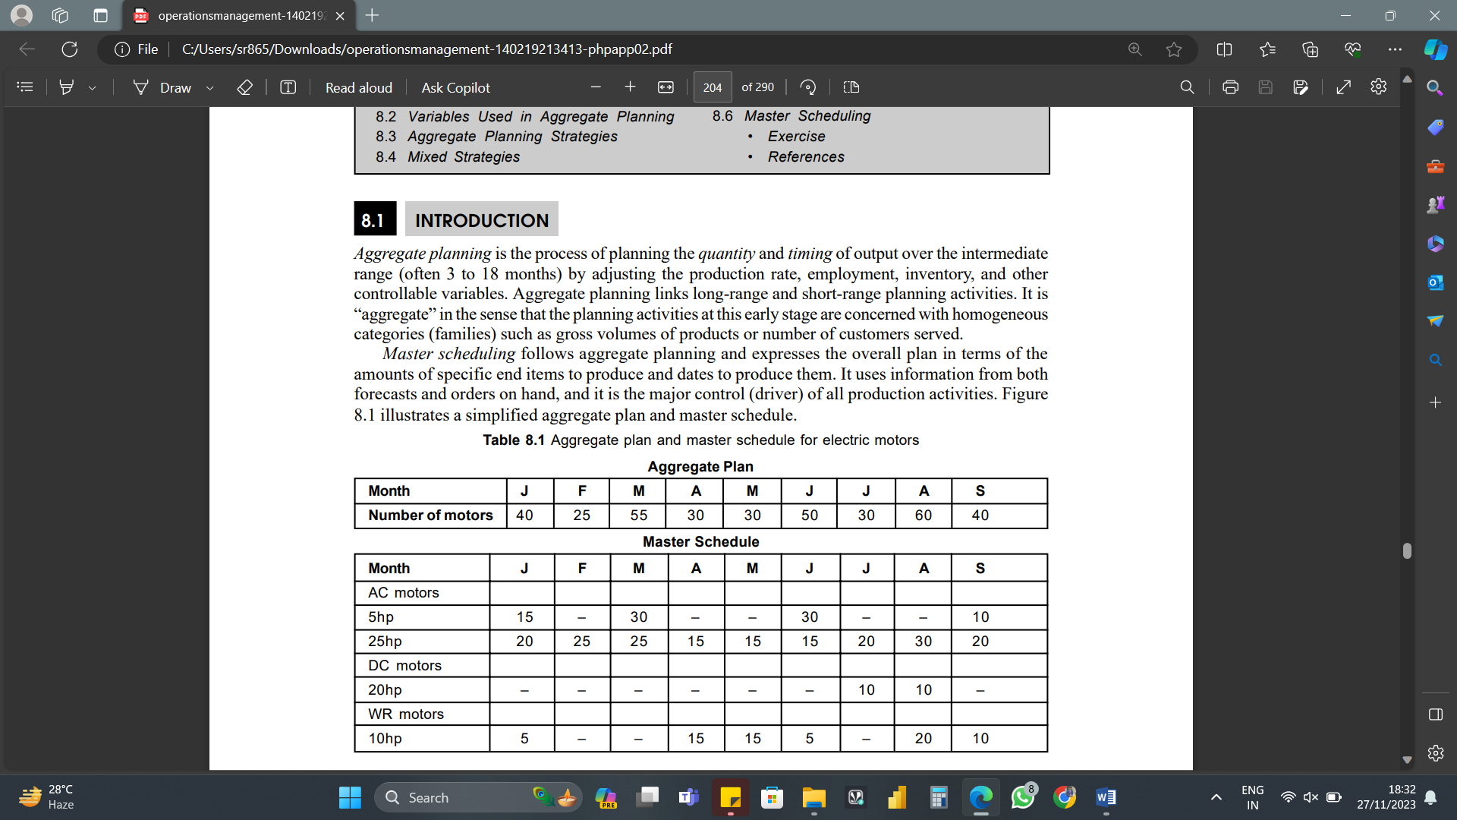
Aggregate Planning Vs. Master Scheduling

Slide 201
Variables used in Aggregate Planning
Aggregate planning is a complex problem largely because of the need to coordinate interacting variables in order for the firm to respond to the (uncertain) demand in an effective way. The below mentioned table identifies some of the key variables available to planners and the costs associated with them.

Slide 202
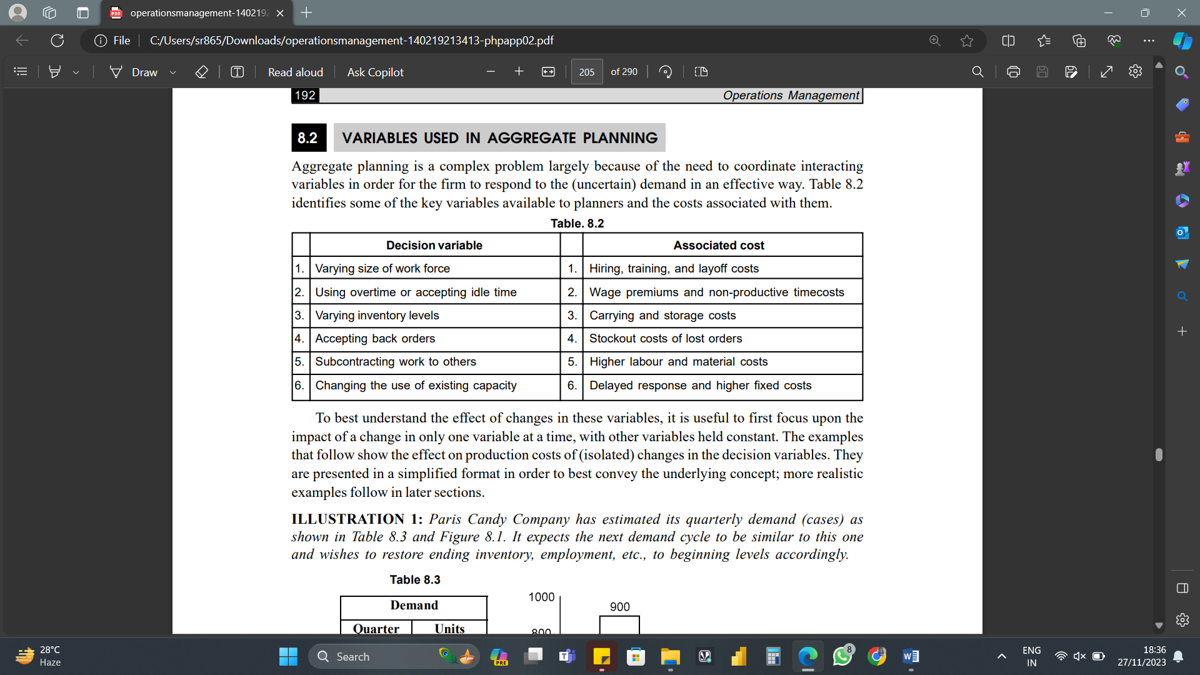
Variables used in Aggregate Planning
Aggregate planning is a complex problem largely because of the need to coordinate interacting variables in order for the firm to respond to the (uncertain) demand in an effective way. The below mentioned table identifies some of the key variables available to planners and the costs associated with them.

Slide 203
Variables used in Aggregate Planning
To best understand the effect of changes in these variables, it is useful to first focus upon the impact of a change in only one variable at a time, with other variables held constant. The examples that follow show the effect on production costs of (isolated) changes in the decision variables. They are presented in a simplified format in order to best convey the underlying concept; more realistic examples follow in later sections.

Slide 204
Aggregate Planning Strategies
Several different strategies have been employed to assist in aggregate planning. Three “pure” strategies are recognized. The pure strategies stem from early models that depicted production results when only one of the decision variables was permitted to vary all others being held constant. Three focussed strategies are:
Chase Demand Strategy
Level Production Strategy
Stable Work-force Strategy

Slide 205
Aggregate Planning Strategies – Chase Demand Strategy
Vary production to match demand by changes in employment (Chase Demand Strategy)
This strategy permits hiring and layoff of workers, use of overtime, and subcontracting as required in each period. However, inventory build-up is not used.

Slide 206
Aggregate Planning Strategies – Level Production Strategy
Produce at a constant rate and use inventories. (Level Production Strategy)
This strategy retains a stable work force producing at a constant output rate. Inventory can be accumulated to satisfy peak demands. In addition, subcontracting is allowed and back orders can be accepted. Promotional programmes may also be used to shift demand.

Slide 207
Aggregate Planning Strategies – Stable Workforce Strategy
Produce with stable workforce but vary the utilization rate (Stable Workforce Strategy)
This strategy retains a stable work force but permits overtime, part-time, and idle time. Some versions of this strategy permit back orders, subcontracting, and use of inventories. Although this strategy uses overtime, it avoids the detrimental effects of layoff.

Slide 208
Aggregate Planning Strategies
We can use the following data in above mentioned tables to illustrate the three focussed strategies described above. These figures display a histogram of a 9-month forecast for motors. The total requirement for the 9 months is 360 motors. This works out to an average (mean) of 40 motors per month, which is shown as a dotted line in the below mentioned graph.

Slide 209
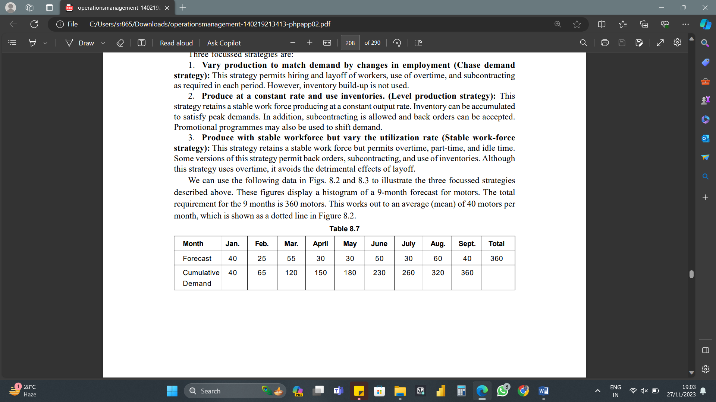
Aggregate Planning Strategies
We can use the following data in above mentioned tables to illustrate the three focussed strategies described above. These figures display a histogram of a 9-month forecast for motors. The total requirement for the 9 months is 360 motors. This works out to an average (mean) of 40 motors per month, which is shown as a dotted line in the below mentioned graph.

Slide 210
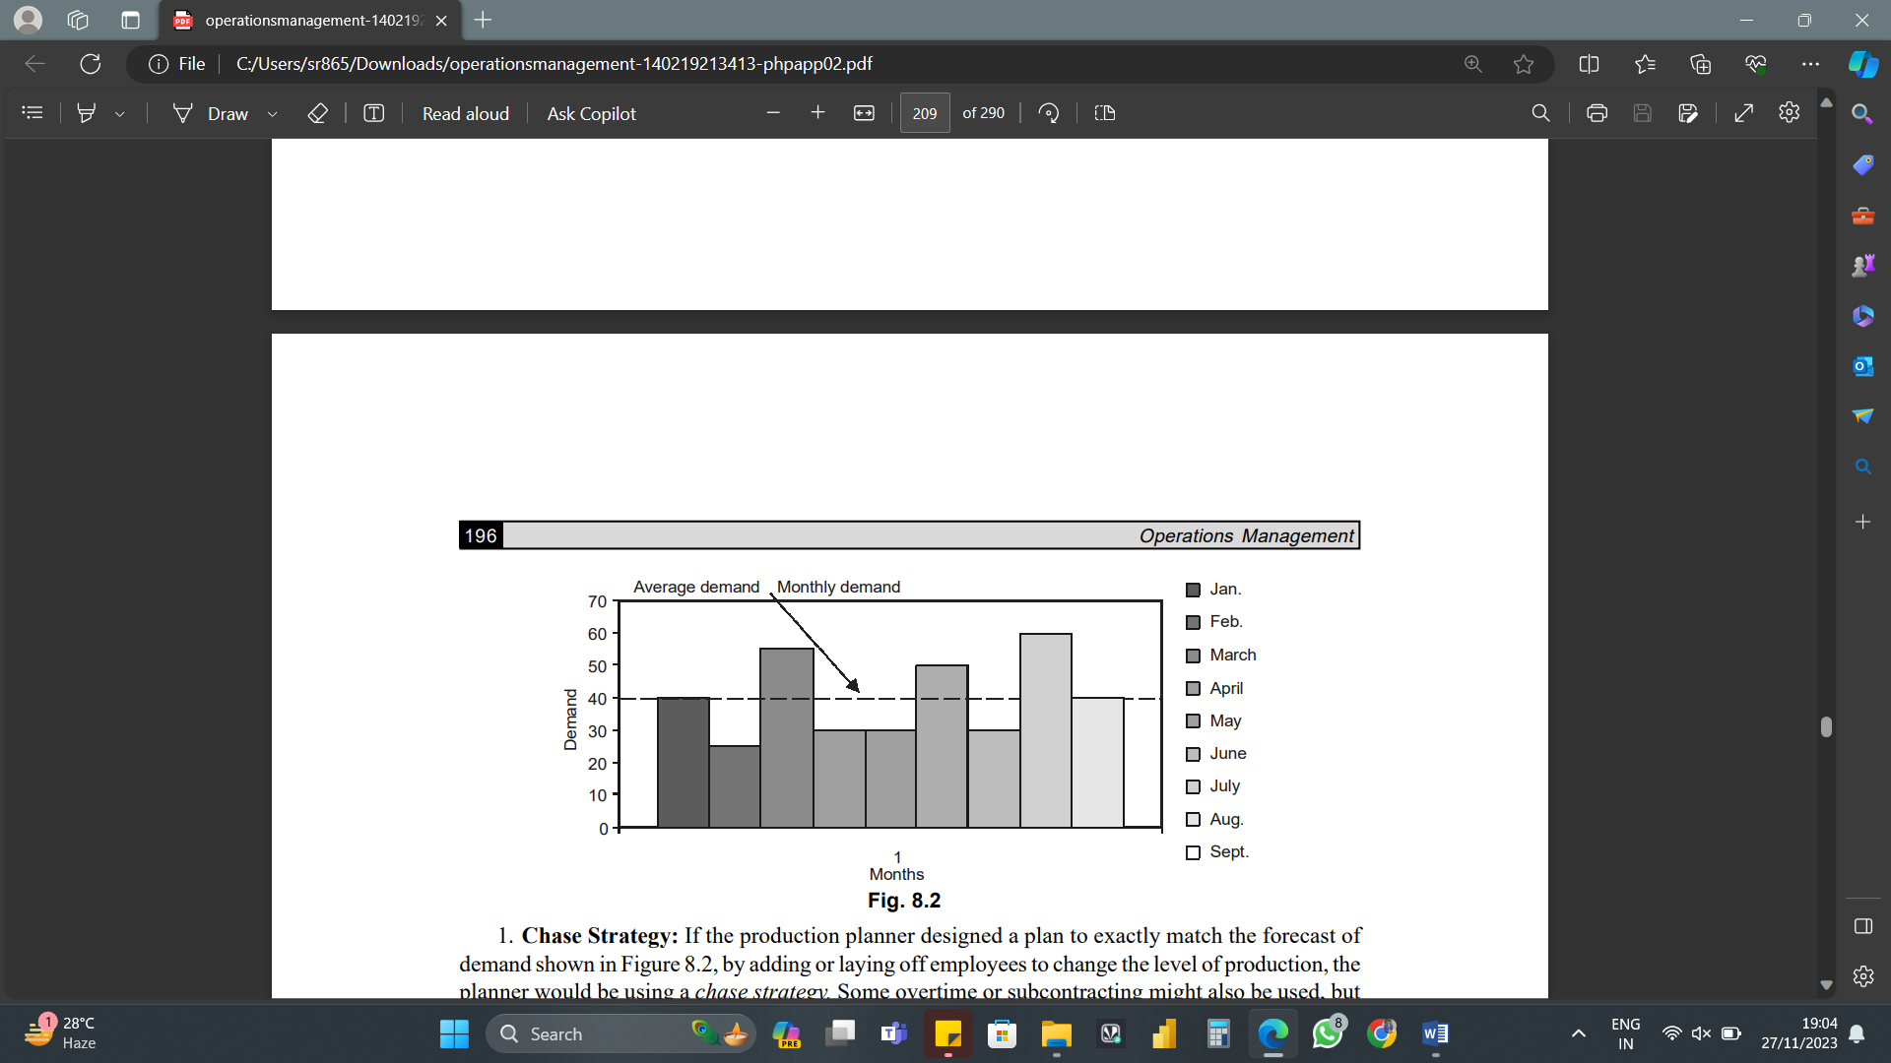
Aggregate Planning Strategies
.

Slide 211
Aggregate Planning Strategies
Chase Strategy
If the production planner designed a plan to exactly match the forecast of demand shown in the graph, by adding or laying off employees to change the level of production, the planner would be using a chase strategy. Some overtime or subcontracting might also be used, but no inventories would be accumulated.

Slide 212
Aggregate Planning Strategies
Level Production Strategy: The graph shows (visually) that the demand exceeds the average requirement in some months and is below average in others. A production plan could be developed to produce at the constant rate of 40 motors per month, accumulating inventory in months 2, 4, 5, and 7, and using that inventory to meet the above average demands in months 3, 6, and 8. Table shows that the cumulative demand (forecast) never exceeds the cumulative averages (production), so no initial inventory is needed to prevent shortages. However, if there were shortages, some back orders could be allowed under a level production, or inventory strategy.

Slide 213
Aggregate Planning Strategies
Stable Work-Force Strategy
Referring to the graph, suppose the firm has a stable work force capable of producing 36 motors per month on regular time. Production might go as high as 60 motors per month by using overtime, but if demand falls to less than 36 motors per month, some workers would be idle. Using overtime and idle time to meet demand would be employing a stable work-force strategy. As part of this strategy, however, it seems likely that planners would build up some inventory during what might otherwise be idle time periods.

Slide 214
Production Planning & Control (PPC) - Production Planning
Production Planning helps manufacturers work smarter by efficiently managing internal resources to meet customer orders or demands. It solves what, when, and how much to produce. It establishes production capacity and identifies what raw materials, bill of materials, or alternate bill of materials are needed to meet demand. Then it prepares a workable production plan.

Slide 215
Production Planning & Control (PPC) - Production Control
Production control monitors production and measures performance, providing visibility and reporting. If any corrective action is needed, it gets initiated with production control. It includes different control techniques to achieve optimal levels of production performance.

Slide 216
Objectives of Production Planning & Control (PPC)
The overall objectives of Production Planning and Control are:
Optimum Resource Utilization: Production planning ensures the best use of the Materials, Men and Machinery.
Consistent Production Flow: PPC aims to achieve consistency in the production flow. This is because, it helps in optimization and waste elimination.
Quality and Cost: It ensures the production of quality goods at the least cost.

Slide 217
Objectives of Production Planning & Control (PPC)
Efficient Production: Through PPC, one can bring efficiency at all stages of the production system.
Materials Management: It optimizes the use of materials and resources by creating plans and schedules.
Fix Bottlenecks: It assists managers in identifying and fixing the bottlenecks in the process.
Scheduling: The planning part of PPC facilitates the creation of schedules for uninterrupted production.
Reduce Idle and Set-up Time: Routing in PPC helps avoid machine idle time and cuts setup time.

Slide 218
Objectives of Production Planning & Control (PPC)
Production Planning and Control is (PPC) the core of any manufacturing unit. It includes material forecasting, master scheduling, long-term planning, demand management, and more. The planning process kicks off with demand forecasting of a product. Using that forecast data and the internal resources available, the production plan is created.

Slide 219
Objectives of Production Planning & Control (PPC)
Production planning and control is a strategy to plan a chain of operations that supports manufacturers to be at the right place and time. It helps them achieve the most efficiency from their resources. It also includes activities of other departments, such as sales, marketing, and procurement.

Slide 220
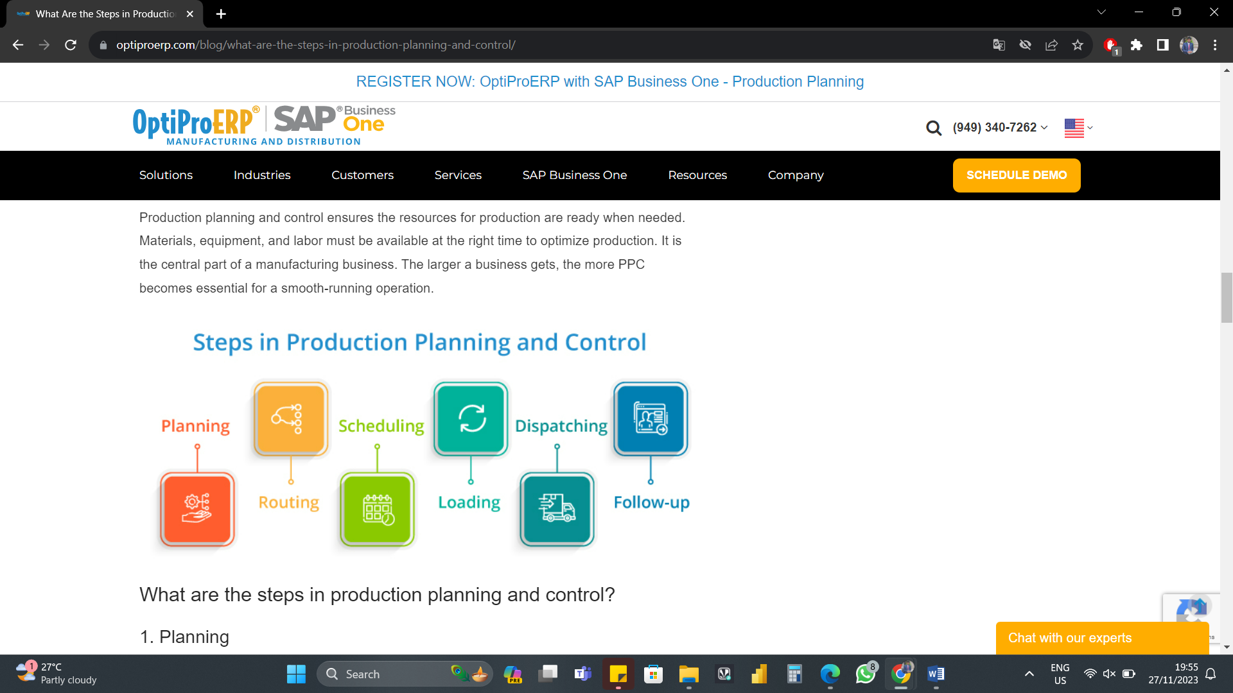
Procedure involved in Production Planning & Control (PPC)
Production Planning and Control (PPC) ensures the resources for production are ready when needed. Materials, equipment, and labor must be available at the right time to optimize production. It is the central part of a manufacturing business. The larger a business gets, the more PPC becomes essential for a smooth-running operation.

Slide 221
Procedure involved in Production Planning & Control (PPC)
1. Planning
Planning determines what will be produced, by whom, and how. It formulates the plan for labor, equipment, work centers, and material requirements needed for production.
Relevant information from various sources helps to develop a production plan. For instance, data from sales on order quantities and promised delivery dates. Product specifications from the engineering department may also be needed. The planning step helps to keep a streamlined approach to the production process.

Slide 222
Procedure involved in Production Planning & Control (PPC)
2. Routing
Routing determines the path raw materials flow within the factory. Using the sequence, raw materials are transformed into finished goods.
Coordinating every production process and scheduling every step is important to measure the production process duration. Routing shows the quantity and quality of materials and resources needed. It also shows the operations used and the place of production.

Slide 223
Procedure involved in Production Planning & Control (PPC)
Routing manages the “How”, “What”, “How much”, and “Where” of production. It systematizes the process and optimizes resources for the best results.

Slide 224
Procedure involved in Production Planning & Control (PPC)
3. Scheduling
Scheduling emphasizes “when” the operation will be completed. It aims to make the most of the time given for the completion of the operation.
As per Kimball and Kimball, the definition of scheduling is –
“The determination of the time that should be required to perform the entire series as routed, making allowance for all factors concerned.”

Slide 225
Procedure involved in Production Planning & Control (PPC)
Organizations use different types of schedules to manage the time element. These include Master Schedule, Operation Schedule, Daily Schedule, and more.

Slide 226
Procedure involved in Production Planning & Control (PPC)
4. Loading
Loading looks into the amount of work loaded against machines or workers. The total time to perform new work is added to the work already scheduled for the machine or workstation.
If a machine or workstation has capacity available, more orders can make up the underload. If there is a capacity overload, proactive measures can prevent bottlenecks. Adding a shift, requesting overtime, bringing in operators from another shop, or using a sub-contractor are possible options.

Slide 227
Procedure involved in Production Planning & Control (PPC)
5. Dispatching
Dispatching is the release of orders and their instructions. It follows the routing and scheduling directions. This step ensures all items are in place for the employees to do their jobs. Here are the points that are part of “Dispatching”:
Issue materials or fixtures that are important for production
Issue orders or drawings for initiating the work
Maintain the records from start to finish
Start the control procedure
Cascade the work from one process to another

Slide 228
Procedure involved in Production Planning & Control (PPC)
6. Follow-up
Also known as expediting, follow-up locates fault or defects, bottlenecks, and loopholes in the production process. In this step, the team measures the actual performance from start until the end and then compares it with the expected performance.
Areas that have problems, must get addressed. Follow-up gets to the root of the issue and helps resolve it. For instance, if schedules are not met, is it from an unusual circumstance? Or is it something that needs to get adjusted? The production manager may need to revise production targets, loads, or schedules to correct the issue.

Slide 229
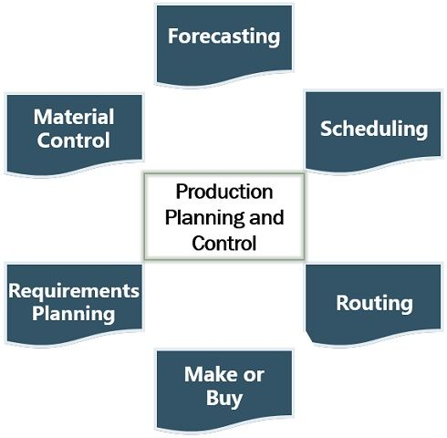
Functions of Production Planning & Control (PPC)
Majorly it performs two functions –Planning and Controlling. However, it also serves the following functions:

Slide 230
Functions of Production Planning & Control (PPC)
Forecasting: The manufacturers make future projections for creating schedules.
Scheduling: It provides the schedule or timetable for manufacturing activities. Therefore, meeting delivery commitments and completing production on time.
Routing: PPC describes the flow of work and the sequence of production activities.

Slide 231
Functions of Production Planning & Control (PPC)
Make or Buy Decisions: It plays an important role in taking make or buy decisions. Generally, these decisions are taken in the planning phase of PPC.
Requirements Planning: PPC determines the exact quantity of materials required for production. Also, it assures the availability of materials whenever needed.
Material Control: Besides availability, it also ensures the best use of resources and eliminates waste.

Slide 232
Work-Method Study Introduction
Method study is an important area in production planning to plan various elements of production, deciding on the type of machine to be used for a specific task, establishing the capacity of the machine, and planning the number of people to be deployed to complete the task. Time study measures the time taken in completing the task whereas method study focuses on the method adopted for completing the task. In method study, an attempt is made to look for alternate actions to complete the task in an efficient and economic way.

Slide 233
Work-Method Study Introduction
A simple example could explain the concept of method study. A student looking for an article on 'Plant Maintenance' goes to a friend and asks the details of various books on plant maintenance. He then goes to a library, looks for the book from subject to subject and shelf by shelf. In case, he is unable to find the book with this topic, he then goes to the librarian to seek his help to search the book and ultimately gets the book. This process takes lots of time and efforts and he gets tired in the process.

Slide 234
Work-Method Study Introduction
Alternatively, he could have directly gone to the library without going to the friend, go to subject index, select the books on the topic, note down the shelf number and book number, go to the shelf and pick up the required book. In the alternate method he takes less than half the time as in the first approach. In this process he cuts down certain activities such as going to the friend, going through the books shelf by shelf, taking help of the librarian and yet completes the same work of searching the article on 'Plant Maintenance’ in much less time and with less efforts.

Slide 235
Work-Method Study Introduction
These days, an article is easily searched with the help of a computer through search engines and Internet. Second method for searching the article is a result of an alternative method in which some of the activities are eliminated. This helped the student to save the time as well as efforts in completing the task by changing the method. He could do some other work in this time, saved by adopting a proper method for the task.

Slide 236
What is Method Study?
Method study is the process by which a method is developed to do a work in the best way in a given situation. In method study, the work is subjected to systematic and critical scrutiny in order to make it more effective and / or more efficient. Any element of the work that could be eliminated or reduced or for which an alternative approach could be adopted to do the work in a simpler way or with less resources comes under the purview of method study.

Slide 237
What is Method Study?
Method study examines if two or more actions could be done simultaneously to complete the task without affecting the quantity and the quality of the work. There is a trade off between the benefits to arrive at an improved method and saving additional cost and time. Often the following questions are addressed in method study:
If the particular element of the task is essential to complete the work?
If the element of the task could be eliminated?

Slide 238
What is Method Study?
If the element of the task could be modified?
If the element of the task could be done more efficiently and economically by the use of another device, technique, technology or skill?
Which elements of the works could be done in parallel?
If the work could be done with the same elements but with modified sequence?

Slide 239
Process of Method Study?
The process is often seen as a linear, described by its main steps of:
Select (the work to be studied);
Record (all relevant information about that work);
Examine (the recorded information);
Develop (an improved way of doing things);
Install (the new method as standard practice);
Maintain (the new standard proactive).

Slide 240
Process of Method Study?
Although this linear representation shows the underlying simplicity of method study, in practice the process is much more one of repeated passes through the sequence of steps with each dominating at a different stage of the investigation.
The cyclic process often starts with a quick, rough pass in which preliminary data are collected and examined before subsequent passes provide and handle more comprehensive and more detailed data to obtain and analyze a more complete picture.

Slide 241
Process of Method Study?
Select
Work selected for method study may be an identified problem area or an identified opportunity. It may be identified through a systematic review of available data, normal monitoring or control processes, high levels of dissatisfaction and complaint or as part of a change in management policy, practice, technology or location, and usually because it meets certain conditions of urgency and/or priority.

Slide 242
Process of Method Study?
Define
Before any method study investigation is begun, it is necessary to establish clear terms of reference which define the aims, scale, scope and constraints of the investigation. This should also include an identification of who "owns" the problem or situation and ways in which such ownership is shared. This may lead to a debate on the aims of the project, on reporting mechanisms and frequencies, and on the measures of success. This process is sometimes introduced as a separate and distinct phase of method study, as the "Define" stage. It leads to a plan for the investigation which identifies appropriate techniques, personnel, and timescale.

Slide 243
Process of Method Study?
Record
The Record stage of method study involves gathering sufficient data (in terms of both quality and quantity) to act as the basis of evaluation and examination. A wide range of techniques are available for recording; the choice depends on the nature of the investigation; the work being studied; and on the level of detail required. Many of the techniques are simple charts and diagrams, but these may be supplemented by photographic and video recording, and by computer based techniques.

Slide 244
Process of Method Study?
Especially with "hard" (clearly defined) problems, method study often involves the construction and analysis of models, from simple charts and diagrams used to record and represent the situation to full, computerized simulations. Manipulation of and experimentation on the models leads to ideas for development.

Slide 245
Process of Method Study?
Examine
The recorded data are subjected to examination and analysis; formalized versions of this process are critical examination and systems analysis. The aim is to identify, often through a structured, questioning process, those points of the overall system of work that require improvements or offer opportunity for beneficial change.

Slide 246
Process of Method Study?
Develop
The Examine stage merges into the Develop stage of the investigation as more thorough analysis leads automatically to identified areas of change. The aim here is to identify possible actions for improvement and to subject these to evaluation in order to develop a preferred solution.
Sometimes it is necessary to identify short-term and long-term solutions so that improvements can be made (relatively) immediately, while longer-term changes are implemented and come to fruition.

Slide 247
Process of Method Study?
Install
The success of any method study project is realized when actual change is made 'on the ground' - change that meets the originally specified terms of reference for the project. Thus, the Install phase is very important. Making theoretical change is easy; making real change demands careful planning - and handling of the people involved in the situation under review. They may need reassuring, retraining and supporting through the acquisition of new skills.

Slide 248
Process of Method Study?
Install, in some cases ,will require a parallel running of old and new systems, in others, it may need the build-up of buffer stocks, and other planning to manage the change. what matters is that the introduction of new working methods is successful. There is often only one chance to make change!

Slide 249
Process of Method Study?
Maintain
Some time after the introduction of new working methods, it is necessary to check that the new method is working, that it is being properly followed, and that it has brought about the desired results. This is the Maintain phase. Method drift is common - when people either revert to old ways of working, or introduce new changes. Some of these may be helpful and should formally be incorporated; others may be inefficient or unsafe. A methods audit can be used to formally compare practice with the defined method and identify such irregularities.

Slide 250
Applications of Method Study
Method study was originally designed for the analysis and improvement of repetitive and manual works. However, its applications are many as it could be used for all types of activities at all levels of an organization. For example, it could be applied in serving food in the canteen, processing of files in the office, issuing the materials from store, carrying out the repair and maintenance jobs in the maintenance department.

Slide 251
Applications of Method Study
It could also be applied in service sectors such as handling of patients in the hospital, receiving passengers at the airport, and conducting examinations in colleges and universities. Method study is applied to any area irrespective of its size and complexities.

Slide 252
Importance of Work-Method Study
Provides better understanding of the work.
Improved planning and control of the work.
Waiting time or in-process-inventory is reduced.
Better delivery schedules to customers.
Reduction in manpower requirements.
Results in reduced production time.
Cost reduction.
Improves quality of the product and better customer satisfaction.

Slide 253
Work Measurement
Work measurement relates to the different ways of finding out how long a job or part of a job should take to complete. It is the process of establishing the time that a given task would take when performed by a qualified worker working at a defined level of performance. The work units comprising the physical and mental works are determined for completing a specified task that use various techniques. The work units are usually in standard minutes or standard hours.

Slide 254
Work Measurement Process
There are many ways and techniques to measure the work. The basic procedure consists of three stages:
• The analysis phase: In this phase the job is divided into convenient and discrete elements.
• The measurement phase: A specific measurement technique is used to establish the time required by a qualified worker working at a defined level of performance to complete each element of work.
• Synthesis phase: The various elemental times are added together with appropriate allowances to work out the standard time for the complete job.

Slide 255
Objectives of Work Measurement
• To analyze the labor needs of an operation.
• To develop labor standards for that operation.
• To measure and analyze deviations from those standards and
• To work for continuous improvement in the labor standards used in that operation.

Slide 256
Significance of Work Measurement
• To develop a methodology for establishing and maintaining standard accuracy.
• Improving operations by conducting engineering analysis.
• Revising standards and related system data.
• To assist in budgeting, estimating, production planning, and performance evaluation using labor standards.

Slide 258
Operations Management
.
Unit – V
Operations Control
Sai Ram B
Lecturer

Slide 259
Operations Control
Operations Control refers to the methods, strategies, and procedures a company uses to manage and control its operational systems. This can include production processes, inventory management, quality control, logistics, and other areas that support the company's day-to-day operations.

Slide 260
Scope of Operations Control
Operations control plays a crucial role in evaluating the effectiveness of a business’s operations and helping visualize its entire production system. With operations control, businesses can understand where resources are being used most efficiently and how they can improve on them.

Slide 261
Scope of Operations Control
At its core, operations control helps businesses tweak, optimize or automate their activities to save time, money, and resources. It also works to pinpoint potential problems and shortfalls with production systems, identify areas for improvement and make sure the organization adheres to safety and legal requirements.

Slide 262
Scope of Operations Control
In daily operations, operations control helps businesses measure performance against goals, forecast successes or failures, manage activities and resources, and ensure customer needs are met.

Slide 263
Classification of Inventories
Efficient inventory management is critical for the success of any business. A business aims to maintain an optimum inventory level that helps in timely meeting customer demand while minimizing costs. Excess inventory or stock-outs both harm the company. Excess inventory increases costs, while a shortage of inventory reduces sales. Both these affect the profit of the business. Thus, one needs to manage the inventory at an optimum level. A crucial aspect of inventory management is the classification of the inventory.

Slide 264
Classification of Inventories
Inventory classification means to group the inventory items based on various parameters. These could be inventory type, contribution to sales, frequency of sales, inventory value.

Slide 265
Classification of Inventories by Inventory Type
A primary inventory classification in any business is by its type. There are the following three types of inventory in a business:
Raw materials
Work-in-process
Finished goods

Slide 266
Classification of Inventories by Inventory Type
Raw Materials: Raw materials are essential products from which one makes the final product. These products are sold to industries and households. Raw materials are mainly obtained from natural resources. Few examples are wood for paper, leather for shoes, milk for sweets, etc.
Work-in-Process (WIP): These are semi-finished goods made of raw materials. Such inventory items are yet to be completed for final sales.
Finished Goods: These are the finished items one sells to the customers.

Slide 267
Classification of Inventories by Contribution to Sales
A few inventory items contribute highly to the sales. Such inventory items are generally given high priority, and more resources are allocated towards their management. They are also monitored strictly. This is because such things drive the profitability of the business to a large extent.

Slide 268
Classification of Inventories by Contribution to Sales
Such an inventory classification is more like the ABC analysis. In this type of analysis, inventory items are categorized into three categories:
Category A includes 20% of the items that contribute 80% to the sales. Category B includes 30% of the items with a 15% contribution to sales. Category C includes the balance of 50% of the items with only a 5% contribution to sales.

Slide 269
Classification of Inventories by Contribution to Sales
Such a classification helps a seller decide on various parameters. He decides the time and resources he should allocate to each category which helps in increasing revenues and reducing costs.

Slide 270
Classification of Inventories by Frequency of Sales
Some inventory items sell quickly, and some sell with a delay. Hence, a seller can classify the inventory items based on the frequency of their sales.

Slide 271
Classification of Inventories by Frequency of Sales
Say, for example, Sam is an automobile dealer. He deals in cars of various brands. In his inventory, he has cars of Mercedes brand and Maruti Suzuki brand. Cars of Mercedes brand do not sell frequently. But when sold, they contribute maximum to sales. Cars of Maruti Suziki brand sell frequently but are relatively lower in value. Hence, contribution to sales is not as high as Mercedes.

Slide 272
Classification of Inventories by Frequency of Sales
However, items such as grains do not sell as quickly as perishables. Such things have a higher shelf life. Hence, once purchased, they can be stored for a reasonable time.
Apart from the above, there are certain items whose demand is difficult to predict. They can be classified into different categories.
Sales frequency helps in deciding the product placement in the warehouse. Frequently selling items can be kept more accessible. A seller can also choose inventory replenishment based on sales frequency.

Slide 273
Classification of Inventories by Value of Inventory
Here, items are classified as high-value items and low-value items. Accordingly, one allocates the time and resources to these items.
To carry out inventory classification, one must adequately map the warehouse. One must create dedicated sections for different product categories wherein all the shelves must be labeled with clarity. This provides quick movement of goods, as per requirement. It also provides direction to employees and reduces errors.

Slide 274
How does Classification of Inventory Help?
Classification of inventory is an essential step in the inventory management system. It helps one make informed decisions for stock replenishment, storage, and sales. One can treat different inventory items according to their importance in the business.

Slide 275
How does Classification of Inventory Help?
For example, one can dedicate more resources towards high-value items selling the highest. Similarly, one can order items with frequent demand more often. One can also track old or stuck goods in the business. One can maintain an adequate buffer for products with stable demand. Thus, it helps in maintaining optimum inventory levels across product categories.

Slide 276
How does Classification of Inventory Help?
A seller can also regularly track the inventory and monitor the most profitable one. This also reduces the chances of theft. It also provides clarity to employees and hence increases their efficiency—all these help improve the sales and profitability of the business.

Slide 277
Inventory Control Using ABC Analysis
ABC (Always Better Control) analysis is one of the most commonly used inventory management methods. ABC analysis groups items into three categories (A, B, and C) based on their level of value within a business.
Classifying inventory with ABC analysis helps businesses prioritize their inventory, optimize operations, and make clear decisions.

Slide 278
Inventory Control Using ABC Analysis
As the name implies, ABC analysis sorts inventory into three main buckets:﻿
A items: This is the inventory with the highest annual consumption value. It should be the highest priority and rarely, if ever, a stock-out.
B items: Inventory that sells regularly but not nearly as much as ‘A’ items. Often inventory that costs more to hold than ‘A’ items.

Slide 279
Inventory Control Using ABC Analysis
C items: This is the rest of the inventory that does not sell much, has the lowest inventory value, and makes up the bulk of the inventory cost.
Inventory categorization is essential with physical products because it protects the profit margins and prevents write-offs and losses for spoiled inventory. It is also the first step in reducing obsolete inventory, supply chain optimization, increasing prices, and forecasting demand.

Slide 280
Inventory Control Using ABC Analysis
Example:
Let’s assume there is an e-commerce women’s accessories boutique. Which just had a good quarter, and finally have the time to analyze inventory. As we can see in the table, earrings are your most popular items, shoes are almost as popular, but neither are pricey, so they don’t generate much revenue. However, the designer purses make up 70% of your revenue, even though only sold 13 of them.

Slide 281
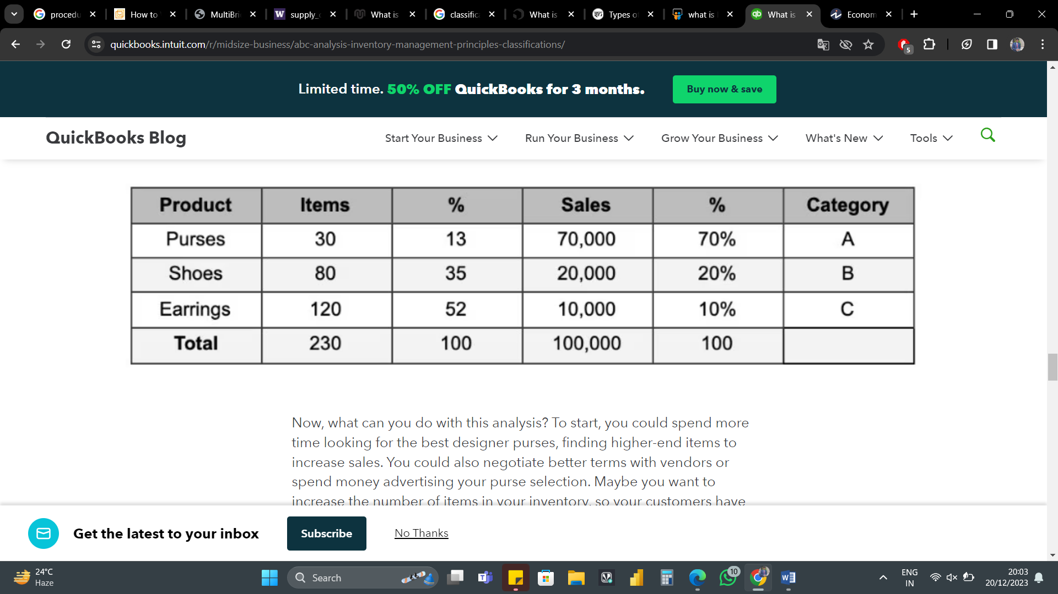
Inventory Control Using ABC Analysis
It’s clear purses should be in category A, shoes in category B, and earrings in category C.

Slide 282
Inventory Control Using ABC Analysis
Now, what can you do with this analysis? To start, they could spend more time looking for the best designer purses, finding higher-end items to increase sales. They could also negotiate better terms with vendors or spend money advertising the purse selection. Maybe want to increase the number of items in the inventory, so your customers have a bigger selection.

Slide 283
ABC Analysis - Advantages
1. More Accurate Demand Forecasting
Using ABC analysis, inventory planners can predict the demand for specific products and manage their inventory accordingly. This insight minimizes carrying costs for obsolete items, thus improves supply chain management.

Slide 284
ABC Analysis - Advantages
2. Better Control of High-Value Inventory
The success of many businesses hinges on A-class inventory. ABC analysis enables you to identify those items in real-time, monitor demand for them, and ensure they are never out of stock. By channeling the resources towards high-priority inventory.

Slide 285
ABC Analysis - Advantages
3. Strategic Pricing
ABC analysis can optimize the pricing strategy for products that bring the most value to the business. Once we understand which products are in high demand, we can increase their price, which can significantly impact profits.

Slide 286
EOQ (Economic Order Quantity) Model
Economic Order Quantity (EOQ) is the ideal quantity of units a company should purchase to meet demand while minimizing inventory costs such as holding costs, shortage costs, and order costs. This production-scheduling model was developed in 1913 by Ford W. Harris and has been refined over time. The economic Order Quantity model assumes that demand, ordering, and holding costs all remain constant.

Slide 287
EOQ (Economic Order Quantity) Model
The goal of the EOQ model is to identify the optimal number of product units to order. If achieved, a company can minimize its costs for buying, delivering, and storing units. The EOQ model can be modified to determine different production levels or order intervals, and corporations with large supply chains and high variable costs use an algorithm in their computer software to determine EOQ.

Slide 288
EOQ (Economic Order Quantity) Model
EOQ is an important cash flow tool. This model can help a company control the amount of cash tied up in the inventory balance. For many companies, inventory is its largest asset other than its human resources, and these businesses must carry sufficient inventory to meet the needs of customers. If EOQ can help minimize the level of inventory, the cash savings can be used for some other business purpose or investment.

Slide 289
EOQ (Economic Order Quantity) Model
Economic Order Quantity is important because it helps companies manage their inventory efficiently. Without inventory management techniques such as these, companies will tend to hold too much inventory during periods of low demand while also holding too little inventory during periods of high demand. Either problem creates missed opportunities.

Slide 290
TQM (Total Quality Management)
Total Quality Management (TQM) is a management approach that seeks to provide long-term success by providing unparalleled customer satisfaction through the constant delivery of quality IT services. To properly execute on TQM methods, the entire organization needs to operate as a single unit in the pursuit of excellence.

Slide 291
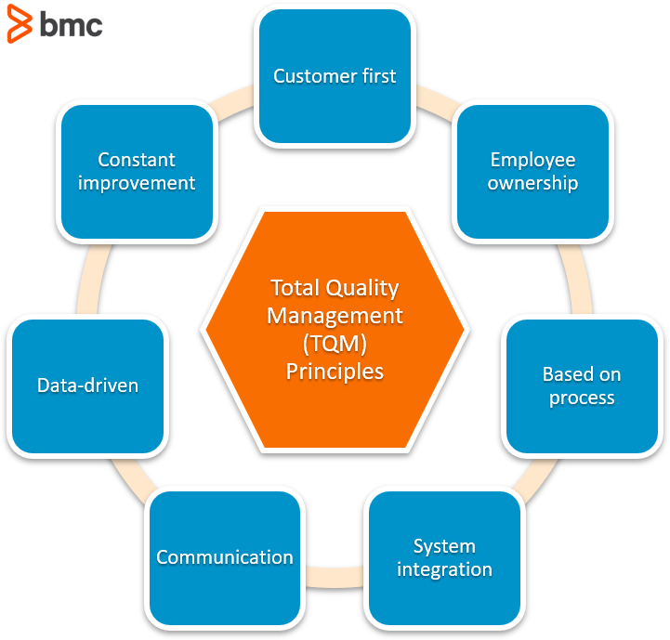
TQM (Total Quality Management)

Slide 292
TQM (Total Quality Management) - Principles
Customer First: TQM’s first and foremost pillar of success is an unwavering focus on the customer’s experience in all interactions with the organization. From first contact through purchase and continued support, the customer should always be the main priority.

Slide 293
TQM (Total Quality Management) - Principles
Employee Ownership: TQM requires the involvement of every team member to ensure that complete quality control is offered at every level. TQM does not focus on a single department because the goal is to provide customers with a great experience from every level of the organization.

Slide 294
TQM (Total Quality Management) - Principles
Process-Based: TQM focuses on the creation and implementation of processes that provide organizations with the ability to find success and repeat it. Quantifying success and defining the steps taken to get there are essential for successful implementation of TQM.

Slide 295
TQM (Total Quality Management) - Principles
System Integration: TQM strategies revolve around leveraging every asset available to the company. This is best achieved through system integrations that combine disparate parts of the organization into a single, well-oiled machine working in complete synergy.

Slide 296
TQM (Total Quality Management) - Principles
Communication: TQM requires every team member to be at their best and to function as a value-adding member of that team. This means communication and transparency is a core tenet of successful TQM practices.

Slide 297
TQM (Total Quality Management) - Principles
Data-Driven: TQM does not employ guesswork. Instead, data is leveraged for the improvement of the organization and decisions are made based on quantifiable facts.
Constant Improvement: TQM is not a one and done process. Perfection is impossible, so it must always be pursued to get the organization as close as possible to it.

Slide 298
TQM (Total Quality Management) - Principles
These pillars of TQM act as a framework for every decision made within the methodology. Whenever the organization feels lost, the TQM ideals are your guiding stars for righting course.

Slide 299
TQM (Total Quality Management) - Advantages
Less Product Pefects: An objective of TQM is to create products and services correctly the first time. This means that products ship with fewer defects, reducing product recalls, future customer support overhead and product fixes.

Slide 300
TQM (Total Quality Management) - Advantages
Satisfied Customers: High-quality products that meet customers' needs result in higher customer satisfaction. High customer satisfaction, in turn, can lead to increased market share, revenue growth via upselling and word-of-mouth marketing initiated by customers.

Slide 301
TQM (Total Quality Management) - Advantages
Lower costs: As a result of less product defects, companies save money on customer support, product replacements, field service and creating product fixes. The cost savings flow to the bottom line, creating higher profit margins.

Slide 302
TQM (Total Quality Management) - Advantages
Well-defined cultural values: Organizations that practice TQM develop and nurture core values around quality management and continuous improvement. The TQM mindset pervades across all aspects of an organization, from hiring to internal processes to product development.

Slide 303
Six Sigma
The term "Six Sigma" refers to a statistical measure of how far a process deviates from perfection. A process that operates at six sigma has a failure rate of only 0.00034%, which means it produces virtually no defects. Six Sigma was developed by Motorola in the 1980s, and it has since been adopted by many other companies around the world, including General Electric, Toyota, and Amazon. It is used in industries such as manufacturing, healthcare, finance, and service industries to improve customer satisfaction, reduce costs, and increase profits.

Slide 304
Six Sigma
Six Sigma is a set of methodologies and tools used to improve business processes by reducing defects and errors, minimizing variation, and increasing quality and efficiency. The goal of Six Sigma is to achieve a level of quality that is nearly perfect, with only 3.4 defects per million opportunities. This is achieved by using a structured approach called DMAIC (Define, Measure, Analyze, Improve, Control) to identify and eliminate causes of variation and improve processes.

Slide 305
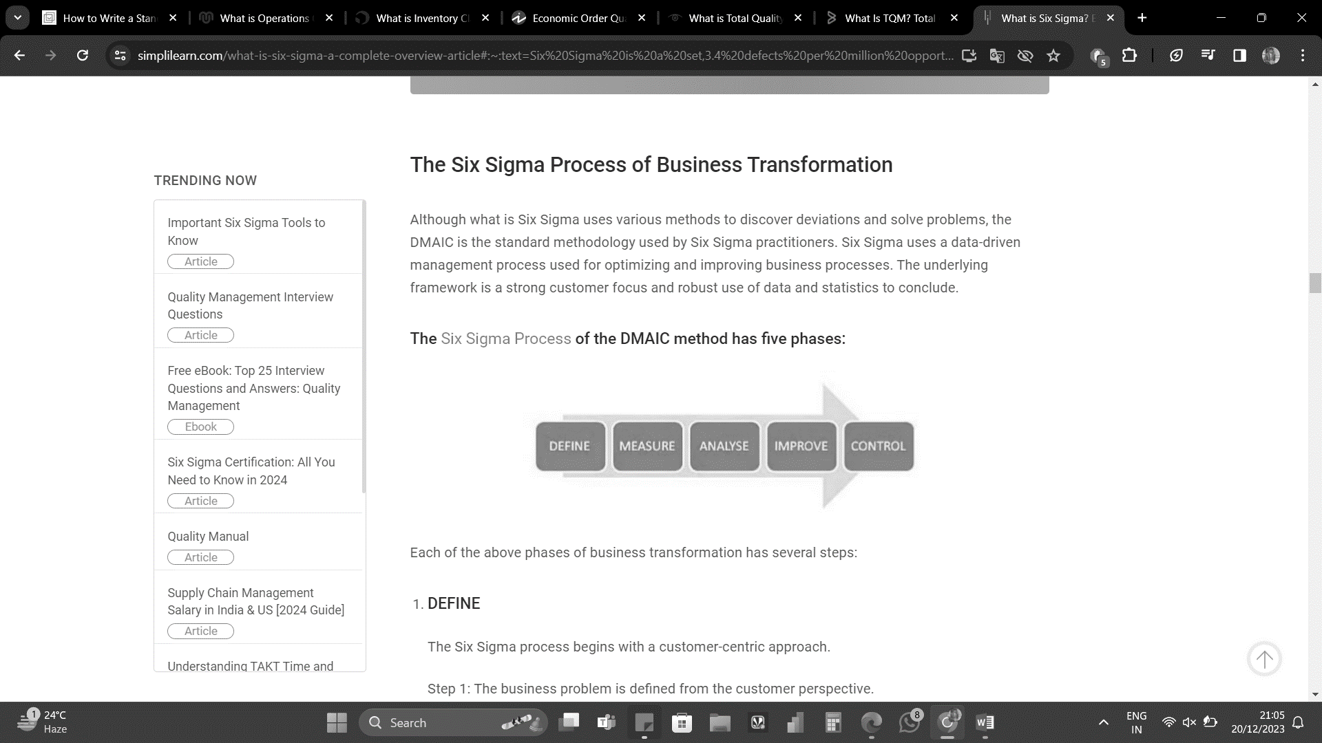
Six Sigma
Six Sigma is a disciplined and data-driven approach widely used in project management to achieve process improvement and minimize defects. It provides a systematic framework to identify and eliminate variations that can impact project performance.

Slide 306
Six Sigma - Principles
The concept of Six Sigma has a simple goal – delivering near-perfect goods and services for business transformation for optimal customer satisfaction (CX).
Focus on the Customer
Measure the Value Stream and Find Your Problem
Get Rid of the Junk
Keep the Ball Rolling
Ensure a Flexible and Responsive Ecosystem

Slide 307
Productivity
Productivity can be treated as a multidimensional phenomenon. The modern dynamic concept of productivity looks at productivity as what may be called “productivity flywheel”. The productivity is energized by competition. Competition leads to higher productivity, higher productivity results in better value for customers, this results in higher share of market for the organization, which results in still keener competition.

Slide 308
Productivity
Productivity thus forms a cycle, relating to design and products to satisfy customer needs, leading to improved quality of life, higher competition i.e. need for having still higher goals and higher share of market, and thereby leading to still better designs.

Slide 309
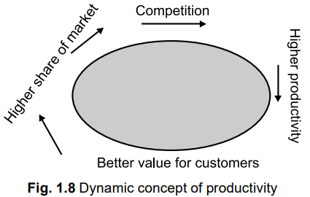
Productivity

Slide 310
Factors Affecting Productivity
Economists site a variety of reasons for changes in Productivity. However some of the principle factors influencing productivity rate are:
1. Capital/Labour Ratio: It is a measure of whether enough investment is being made in plant, machinery, and tools to make effective use of labour hours.
2. Scarcity of Some Resources: Resources such as energy, water and number of metals will create productivity problems.

Slide 311
Factors Affecting Productivity
3. Work-Force Changes: Change in work-force effect productivity to a larger extent, because of the labour turnover.
4. Innovations and Technology: This is the major cause of increasing productivity.
5. Regulatory Effects: These impose substantial constraints on some firms, which lead to change in productivity.

Slide 312
Factors Affecting Productivity
6. Bargaining Power: Bargaining power of organized labour to command wage increases excess of output increases has had a detrimental effect on productivity.
7. Managerial Factors: Managerial factors are the ways an organization benefits from the unique planning and managerial skills of its manager.
8. Quality of Work-life: It is a term that describes the organizational culture, and the extent to which it motivates and satisfies employees.

